Slide 1
The Experiential Library
A Platform for Teaching, Learning, & Research
Greg Raschke, Senior Vice Provost & Director of Libraries

Slide 2
Our Vision
To be NC State’s
competitive advantage

Slide 3
Strategic Priorities
To enhance student success and promote affordability

Slide 4
Strategic Priorities
To enhance student success and promote affordability
To provide a platform for research infrastructure

Slide 5
Strategic Priorities
To enhance student success and promote affordability
To provide a platform for research infrastructure
To be a gateway to the community

Slide 6
Strategic Priorities
To enhance student success and promote affordability
To provide a platform for research infrastructure
To be a gateway to the community
To raise the profile of the university

Slide 7
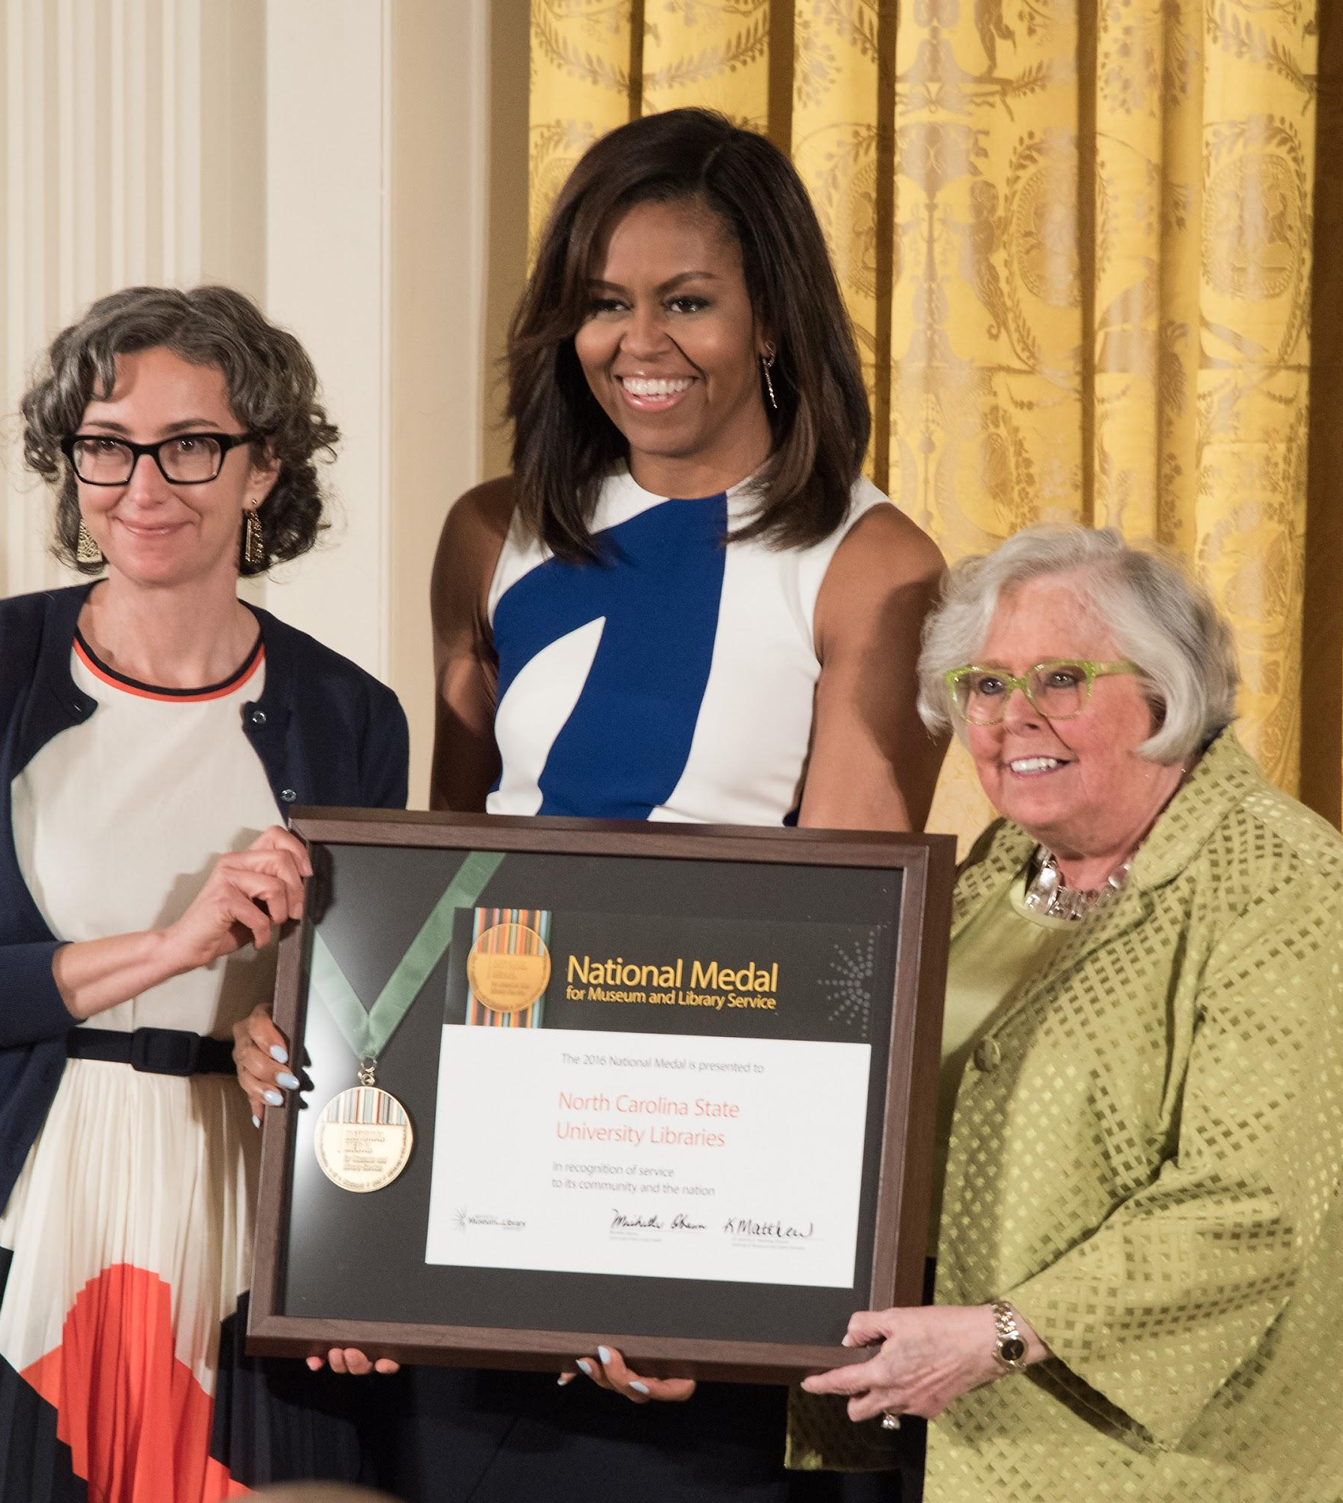
A Culture of Excellence
2016 IMLS National Medal for Library Service
2017 Library Journal’s “New Landmark Libraries”
2018 ALA “Library of the Future Award”
11 Library Journal Mover & Shaker Awards—most of any academic library
Stanford Prize for Innovation in Research Libraries
3 ALA Cutting-Edge Library Service Awards

Slide 8
Sustaining Principles
To have the best staff in North America

Slide 9
Sustaining Principles
To have the best staff in North America
To be an incubator for emerging technologies

Slide 10
Sustaining Principles
To have the best staff in North America
To be an incubator for emerging technologies
To design premier spaces

Slide 11
Sustaining Principles
To have the best staff in North America
To be an incubator for emerging technologies
To design premier spaces
To nurture a culture of experimentation and creativity

Slide 12
Sustaining Principles
To have the best staff in North America
To be an incubator for emerging technologies
To design premier spaces
To nurture a culture of experimentation and creativity
To always be aspirational and ambitious

Slide 13
New Areas of Emphasis
Deepening Partnerships and Alignment

Slide 14
New Areas of Emphasis
Deepening Partnerships and Alignment
Collaborative approach to space planning and use, holistically meeting student and faculty needs

Slide 15
New Areas of Emphasis
Deepening Partnerships and Alignment
Collaborative approach to space planning and use, holistically meeting student and faculty needs
Technology refresh, focused on accessibility and maximizing use

Slide 16
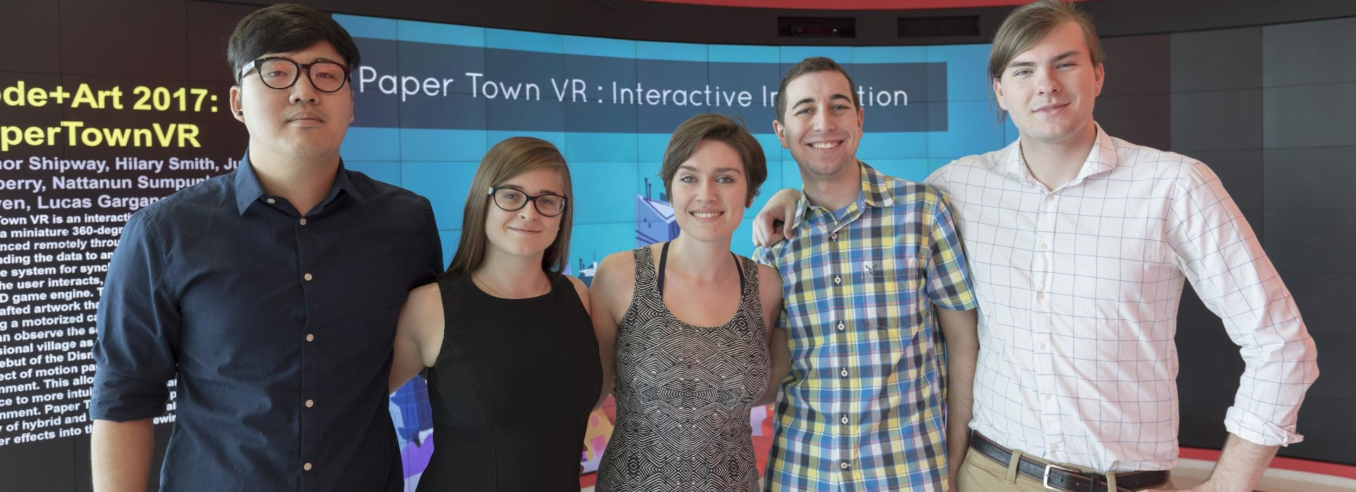
The Intersection of Student Success
and Affordability

Slide 17
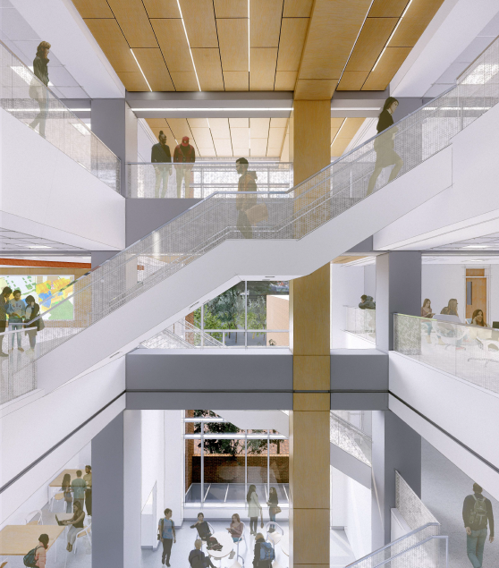
Hill Library Renovation
Creating pathways for sharing and celebrating student work
Fostering discovery and creativity for students
Providing a platform for deeper learning, creative exploration, peer-to-peer interaction, and skill development
Enriching the educational experience and student life at NC State
Notes:
Holistic approach to student success.
Will include writing center, tutoring, undergraduate research, and career counseling.
Building programmatic partnerships now - goal sis to make them the model of integration and quality space in the nation. More common to see tenancy approaches to library spaces - we will accept nothing less than partnership.
We want explore and demonstrate the relationship between these and library services and beneficial impact on retention, graduation rates, and student performance.

Slide 18
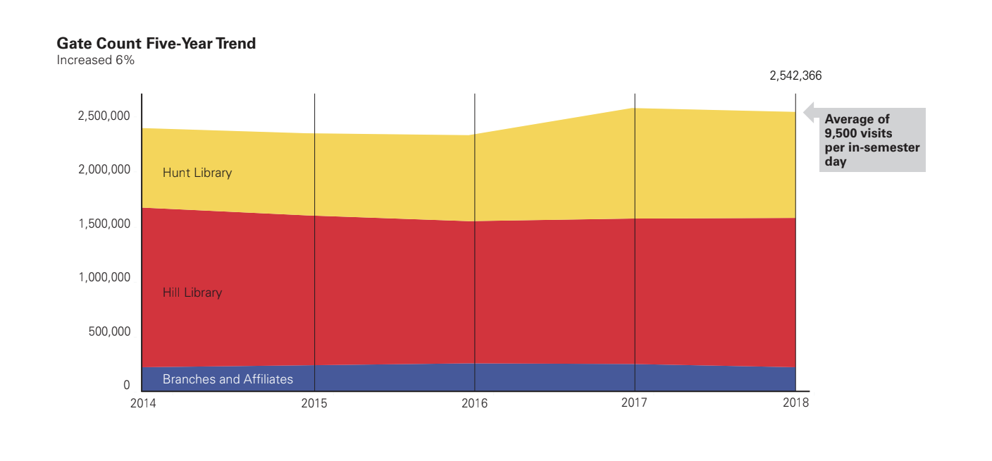

Slide 19
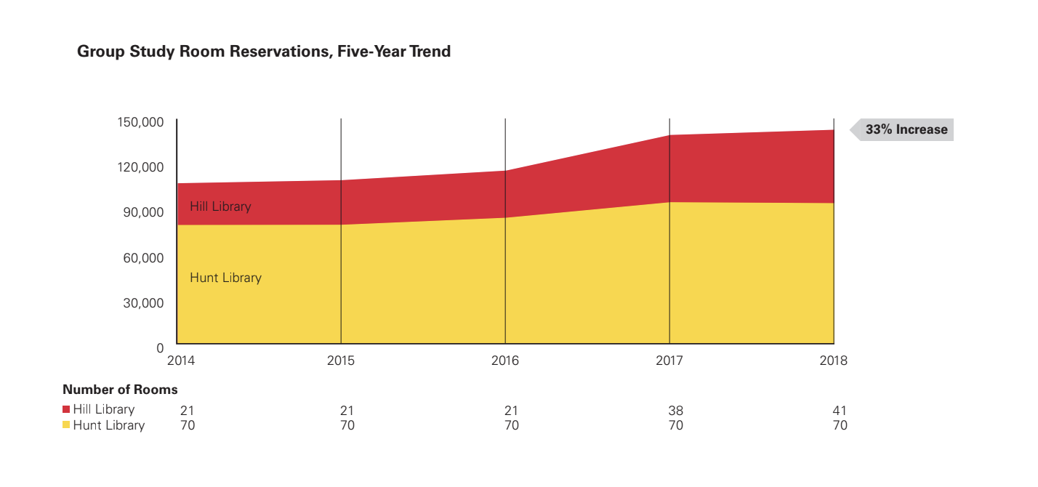

Slide 20
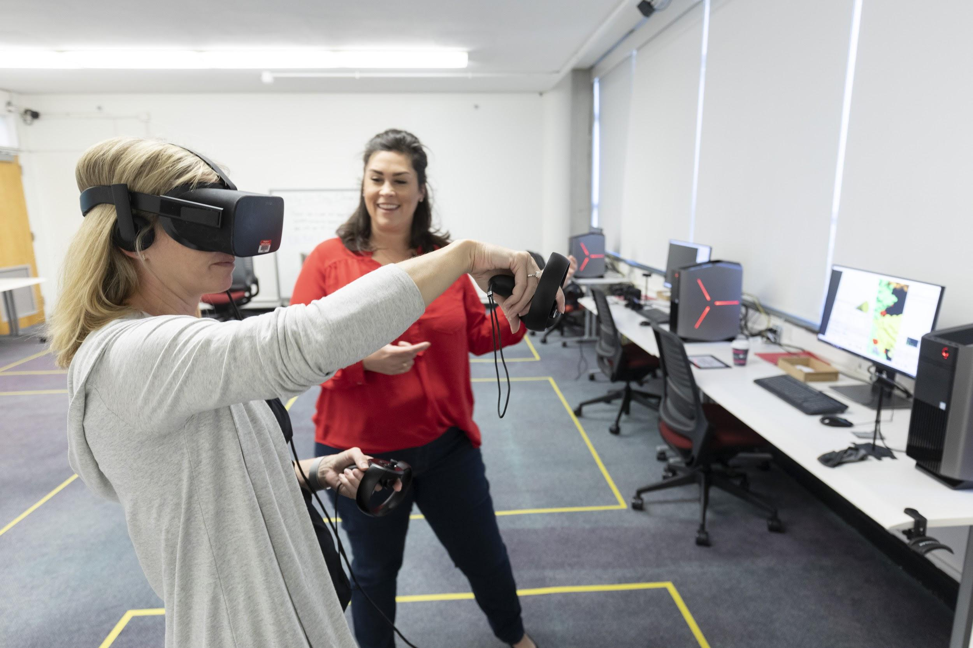
Active and Experiential Learning
College of Textiles alumnus Jazsalyn McNeil created her “Pulse Dress,” which incorporates LEDs that blink with the wearer’s heartbeat, in our Makerspace.
Making Space speaker Meghan McCarthy guides attendee through a “molecular spelunking” journey using UCSF ChimeraX.
Notes:
As the educational experience becomes quote.

Slide 21
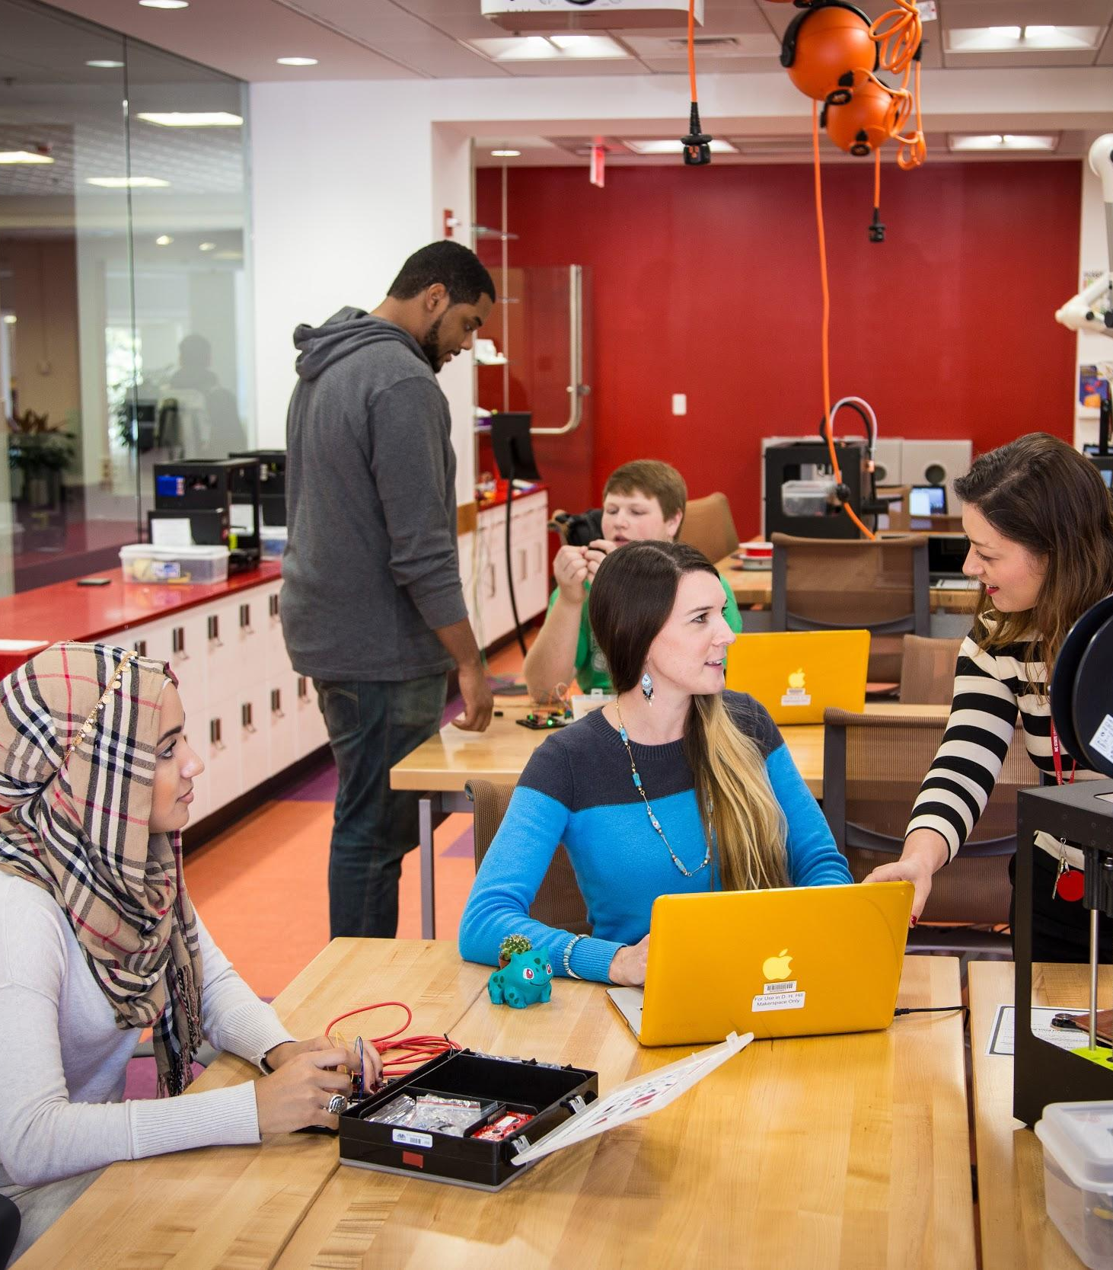
Active and Experiential Learning
Hands-on access to the emerging technologies of making.
Enable students and faculty to work with 3D printing, 3D scanning, electronics prototyping, and other Maker tools.
Maker tools are available through our Technology Lending Service.
Notes:
Paul Fyfe class example.

Slide 22
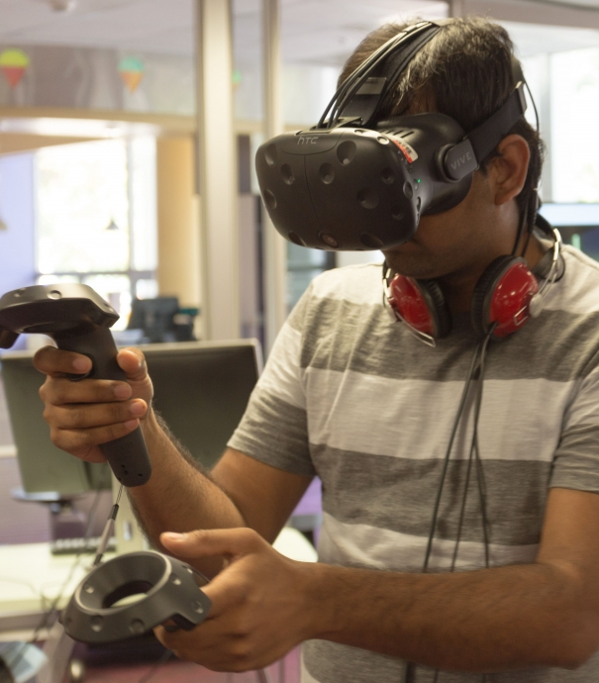
Active and Experiential Learning
Virtual reality (VR) provides new ways for people to interact with information and media.
The VR Studio at the D. H. Hill Jr. Library is a space for experimenting with and creating immersive content.
Eight workstations representing the two major VR platforms, the Oculus Rift and the HTC Vive, and other equipment.
Notes:
Maria Gallardo-Williams example.

Slide 23
Active and Experiential Learning
Future Innovation Studio, Hill Renovation
Impactful teaching and learning space
Emerging technology instruction
Digital and physical storytelling
Interactive exhibits
Office of Undergraduate Research partnership
Full-space utilization by classes

Slide 24
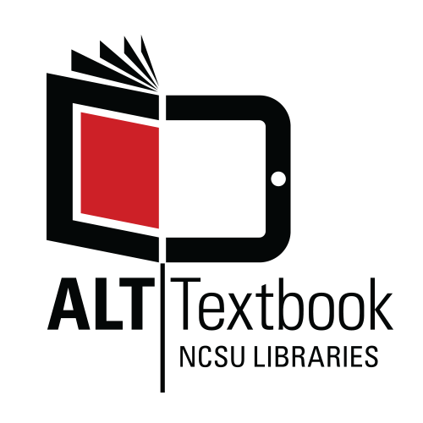
Textbook Affordability
Addressing the problems of high textbook costs and access code lock-in
Textbook Lending and Course Reserves services
OER courses saved UNC system students more than $1.8 million in 2017-18.
Open Education North Carolina has saved NC students more than $3.6 million.
The Libraries’ Textbook and Alt-Textbook programs save students over $400,000 every year.
Notes:
At NC State, a number of groups including DELTA, the Libraries, the NC State Bookstores, and Student Government have taken steps in recent years to begin to address the problem of high textbook costs and access code lock-in.
The Libraries, in partnership with the Bookstores, purchases at least one copy of each required textbook for its Textbook Lending Service and makes them available at no cost to the student. The Course Reserves service provides additional assigned or supplemental materials. (METRIC: # loans?)
DELTA and the Libraries offer grant programs to redesign pedagogy around openly available resources and textbooks, eliminating traditional textbooks and their costs while promoting active teaching and learning.
The Libraries has partnered with other UNC System institutions to convert courses to OER, saving students more than $1.8 million in 2017-18 and with NC LIVE, a statewide electronic resource consortium, to develop Open Education North Carolina, a program that has saved NC students more than $3.6 million.

Slide 25
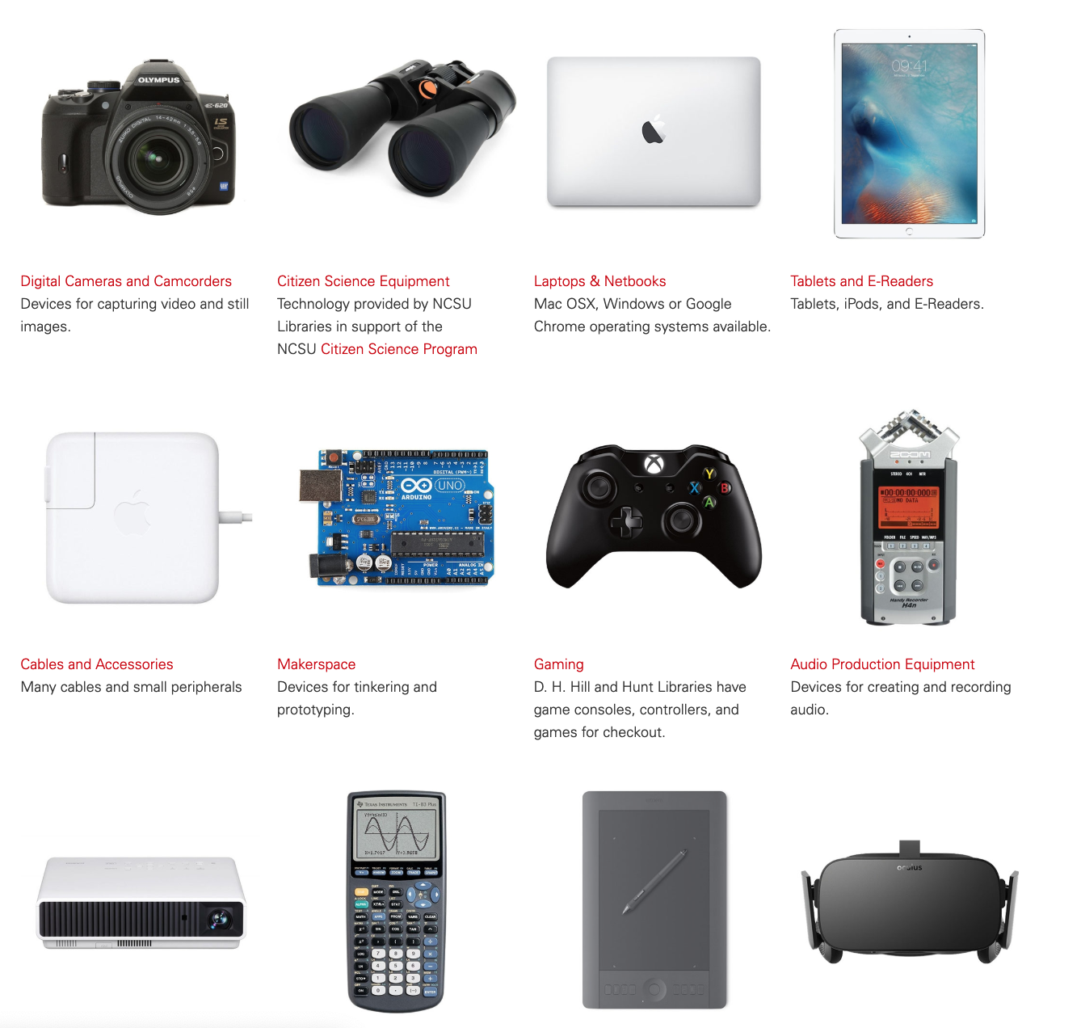
Technology Affordability
User-driven technology lending
Scaffolded support: workshops, peer consultations, Lynda.com tutorials, etc.
Democratic access to tools and resources that levels the playing field for all students
Notes:
[Access to tech, both practical and advanced speaks to the student learning needs at a STEM institution; it speaks to equity of access to all students, regardless of their economics or background; and it speaks to general issues of affordability.]
All NC State students have access to technology that they can borrow and access to technology-equipped spaces like the Dataspace, music booths, and the VR Studio.
Tech lending includes laptops and chargers that keep students charged and productive. It also helps them out of a jam when they lose their laptop charger the day before finals.
We also lend cameras and microphones and Raspberry Pis so that all students have what they need for their projects, whether academic or personal.
Access to emerging technologies for coursework, co-curricular learning
Patron-suggested technology recs. through website
Complemented by peer consultations, lynda.com tutorials, workshops
Access ensures that NC State students have to tools to develop their digital and data literacies
Certificate program in Digital Media
Certified Media Maker badging initiative was developed in 2018 and began in earnest in spring 2019
Utilizes existing curricula - foundational digital media workshops (video and audio) and advanced digital media workshops (photography, sampling/beatmaking, individualized soundmaking sessions) in which patrons work with library staff to use physical spaces and technologies to create a media project during a set amount of time - to inspire both confidence and willingness to use library spaces/services to make media.
Combines workshops with more specific lynda.com training - a robust training software available to all NC State students, faculty, staff
Exposes and promotes our consultation culture by requiring an online portfolio of media projects to be created, with the help of library media consultants

Slide 26
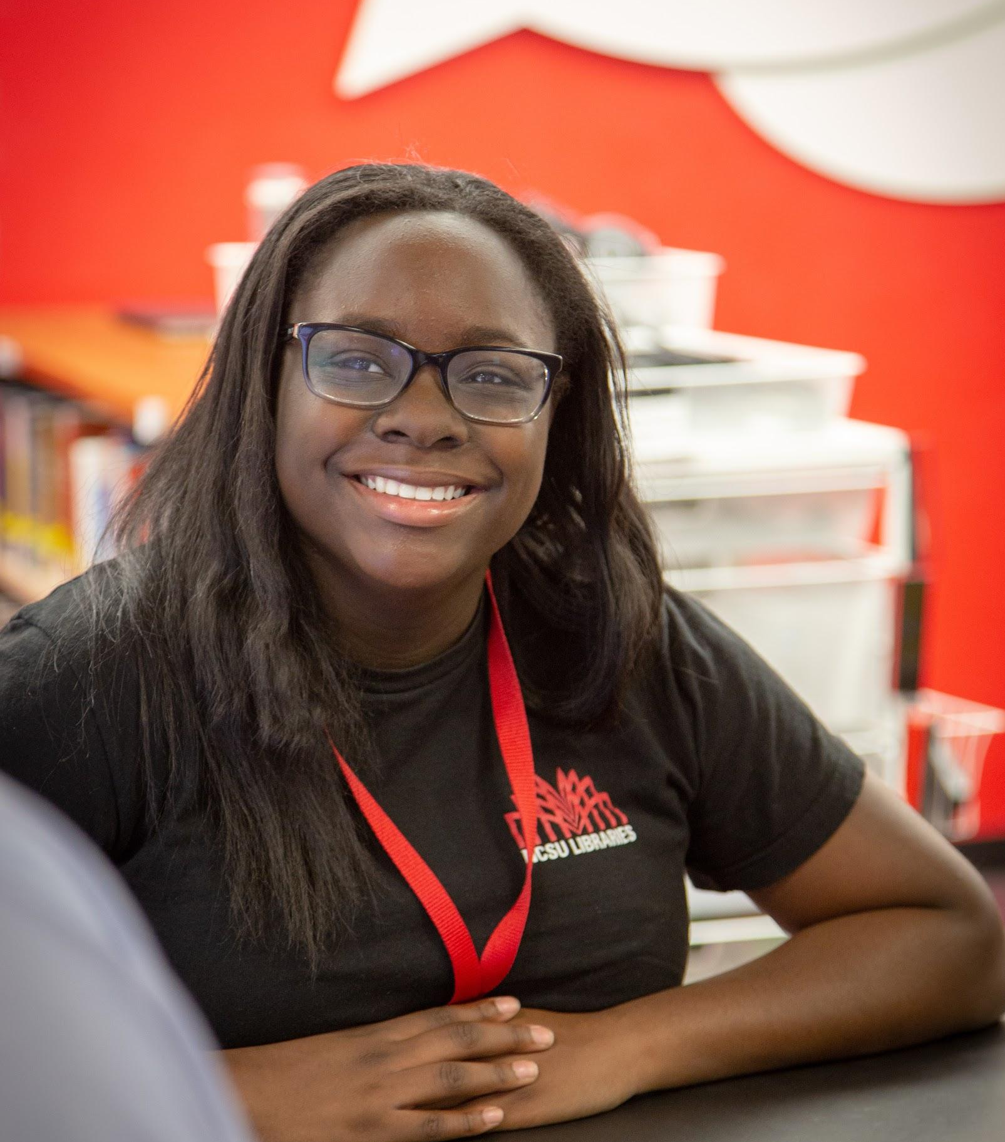
Student Employment
250 Student Employees
Providing a positive, meaningful work experience for a diverse group of students drawn from all disciplines and backgrounds
First Student Scholarships and Fellowships within Last 18 Months
Graduate Student Support Plan (GSSP)
Peer-to-peer student management program
Opportunities for professional development
Notes:
Chantal Warfield is also all about communication—communicating a love of reading to young people. Warfield has wanted to be a librarian since she was in middle school, inspired by the teen and children’s services librarian at the Grissom Public Library in Newport News where she spent part of her childhood.
Julia Velasquez has been with the Libraries almost since she set foot on campus at NC State. Now a senior and on the verge of her degree in Materials Engineering, she started as a student worker at the Hill Library Ask Us desk the first semester of her freshman year.

Slide 27
Notes:
“Students teach students in the Peer Scholars Program”
Partnering with the Graduate School to expand the scope and reach of program
This program provides the Libraries the opportunity to serve as the hub while partnering more closely with early career researchers to deliver relevant and in demand content that they use in the wild.
Peers are teaching Peers and telling us what their research community needs.

Slide 28
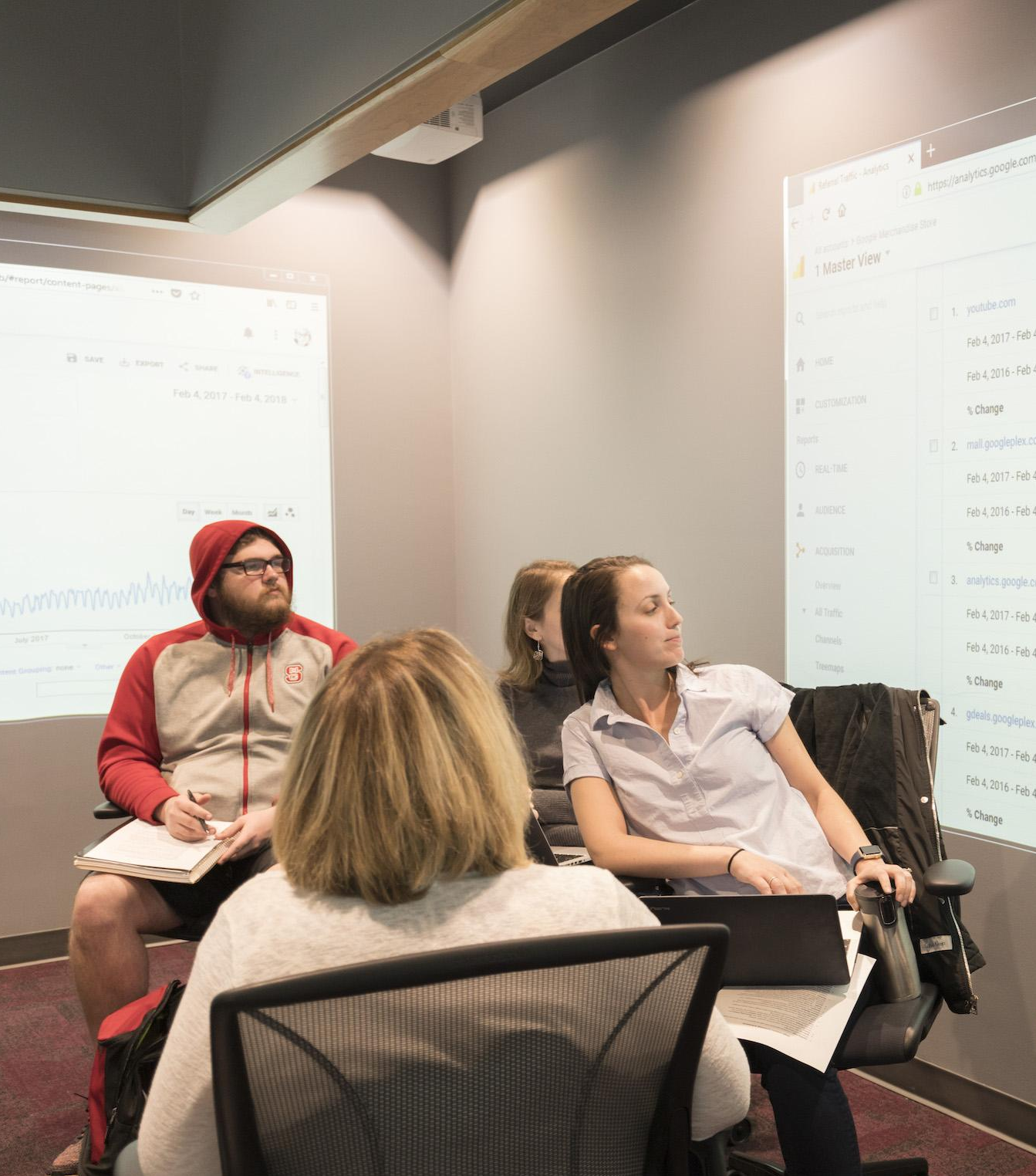
Peer Scholars Feedback
“Participation in the Peer Scholars Program led directly to being offered a Graduate Research Assistantship in my department. I am thankful to the Libraries for the opportunity and support in organizing these efforts!” - Amrutha Raghu, MS Candidate, Chemical Engineering
“The Peer Scholars Program is a great transition into teaching at the professional level where I can develop and teach my own materials. Because I am teaching peers, it is a friendly environment and has allowed me to practice more advanced communication and teaching techniques compared to techniques I use with my freshman students. I've gained confidence in my teaching skills and have enjoyed helping other graduate students and postdocs develop their professional portfolios.” — Dianna Francisco, PhD Candidate, Atmospheric Science

Slide 29
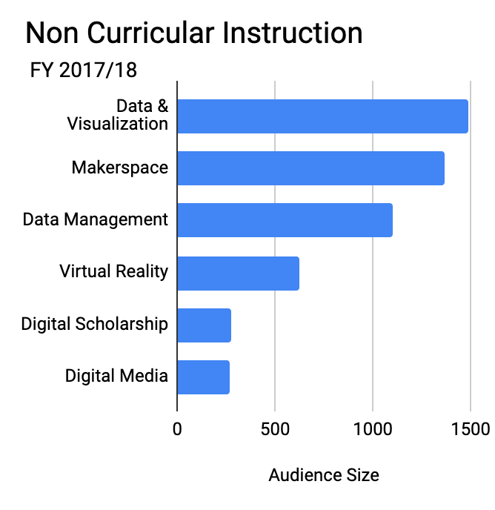
Non-curricular Instruction
Total number of instruction sessions up 60% over last five years
35% of 2017/18 sessions focused on new tools and skills: Data Science, Visualization, Digital Media, Making, Virtual Reality, Digital Scholarship, etc.
Student demand and workshop offerings continue to increase

Slide 30
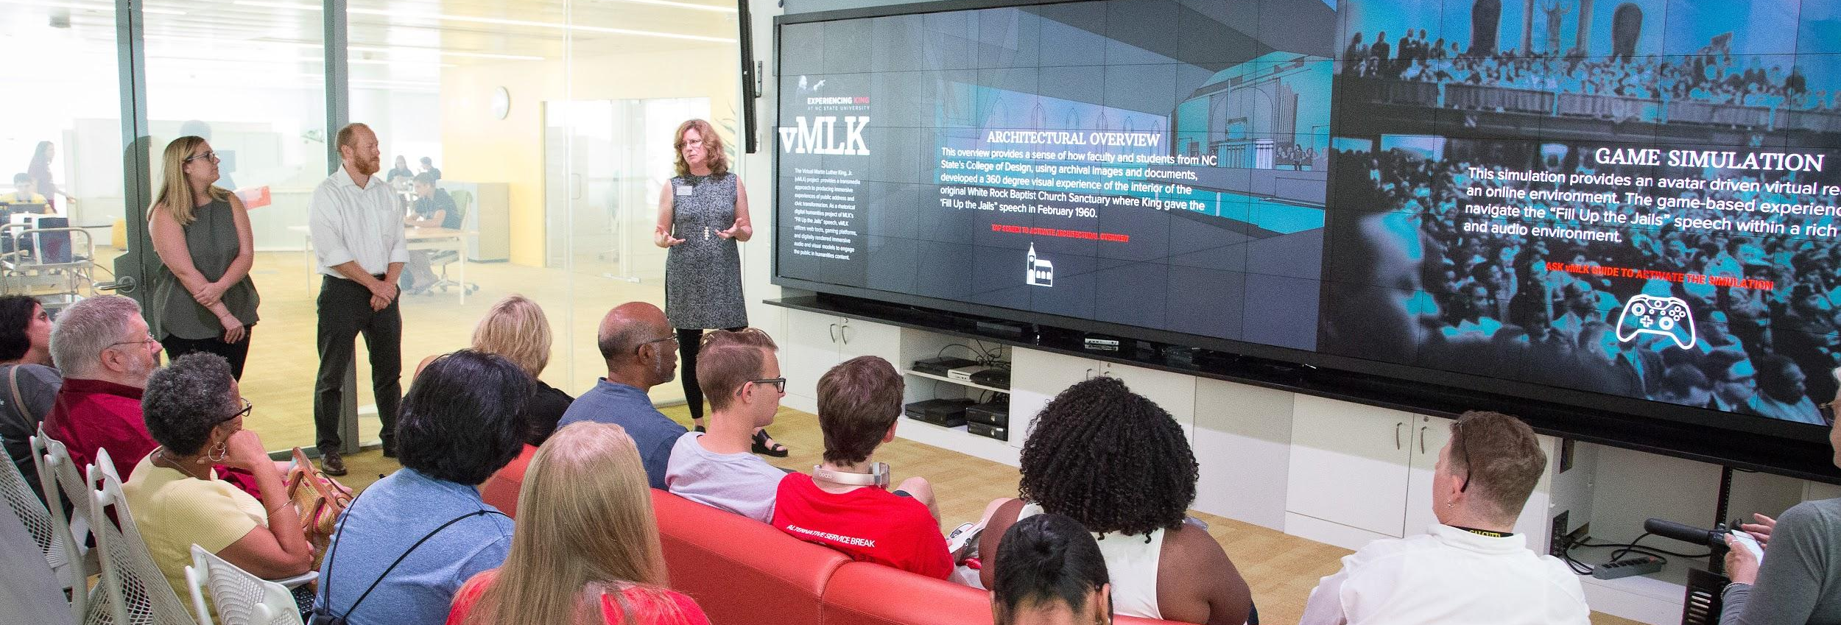
Platform for Research Infrastructure

Slide 31
Collections as Core Infrastructure
5.3+ million physical and online volumes
1.2 million+ ebooks
128,000+
journals (99% online)
Over 635 databases
Notes:
We have a lot of resources that are available 24/7.

Slide 32
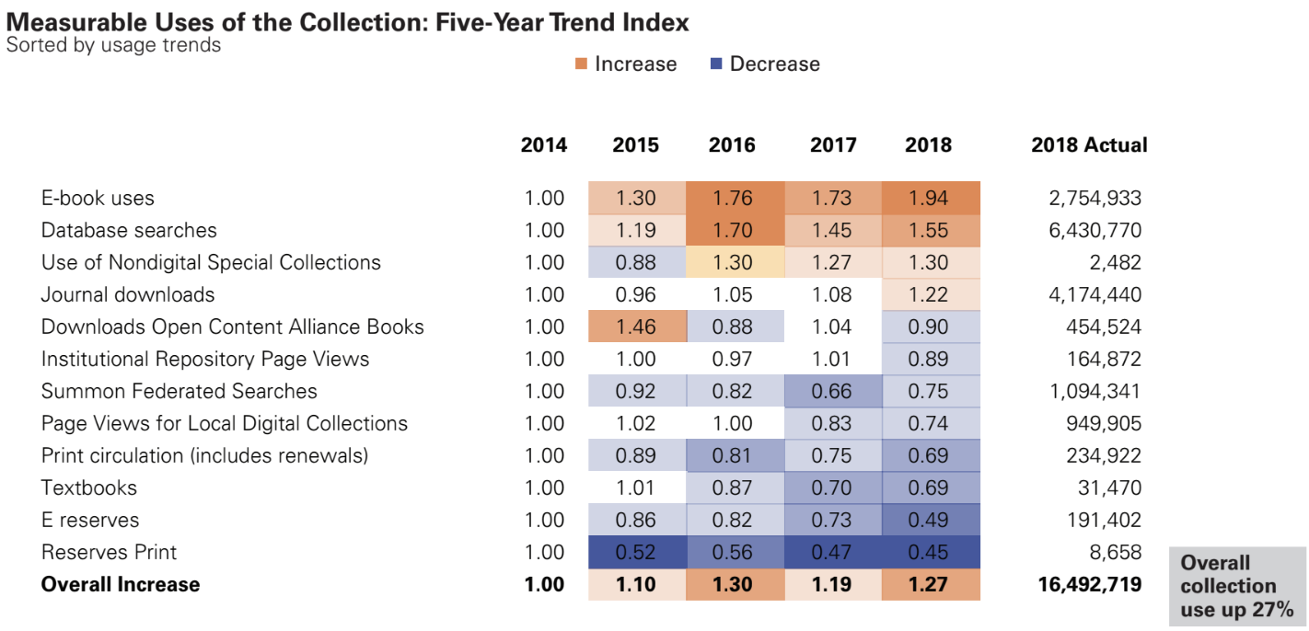
16.5 million
uses of our collection in 2017/18 (up 7%)
4.1 million
full-text journal downloads in 2017 (up 13%)
7.5 million
database searches in 2017 (up 18%)
Notes:
And they are used A LOT!!!

Slide 33
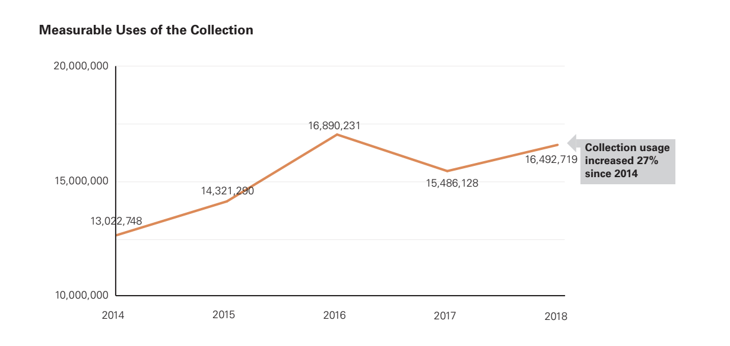

Slide 34
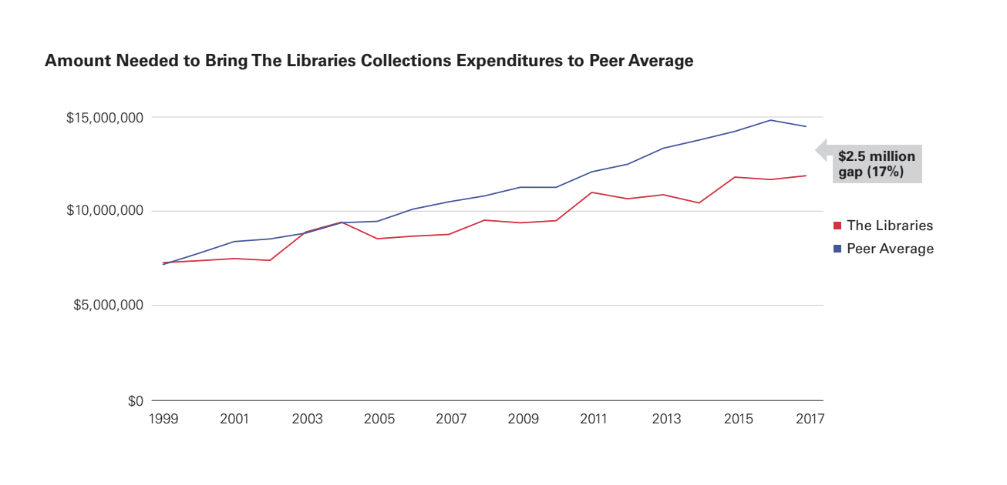
Notes:
While we do more with less (Vickery’s work on our efficiency compared to UNC system peers), there’s a significant disparity.
We have the lowest cost-per-use download costs of any member of the UNC system.

Slide 35
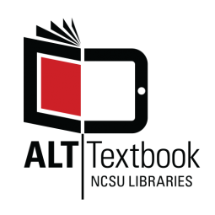
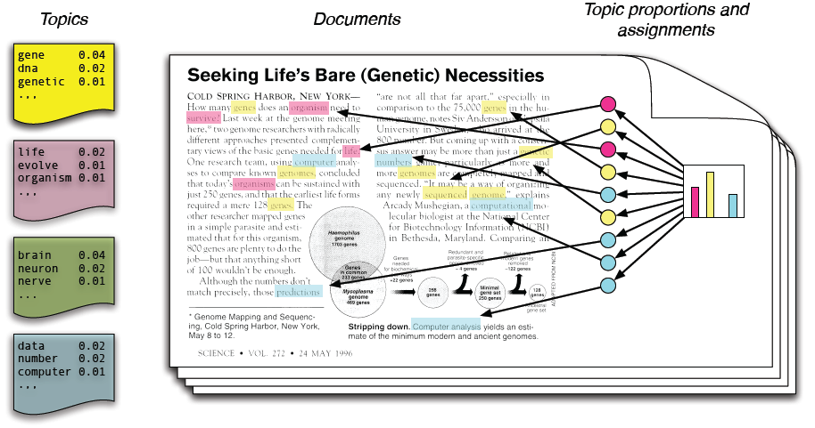
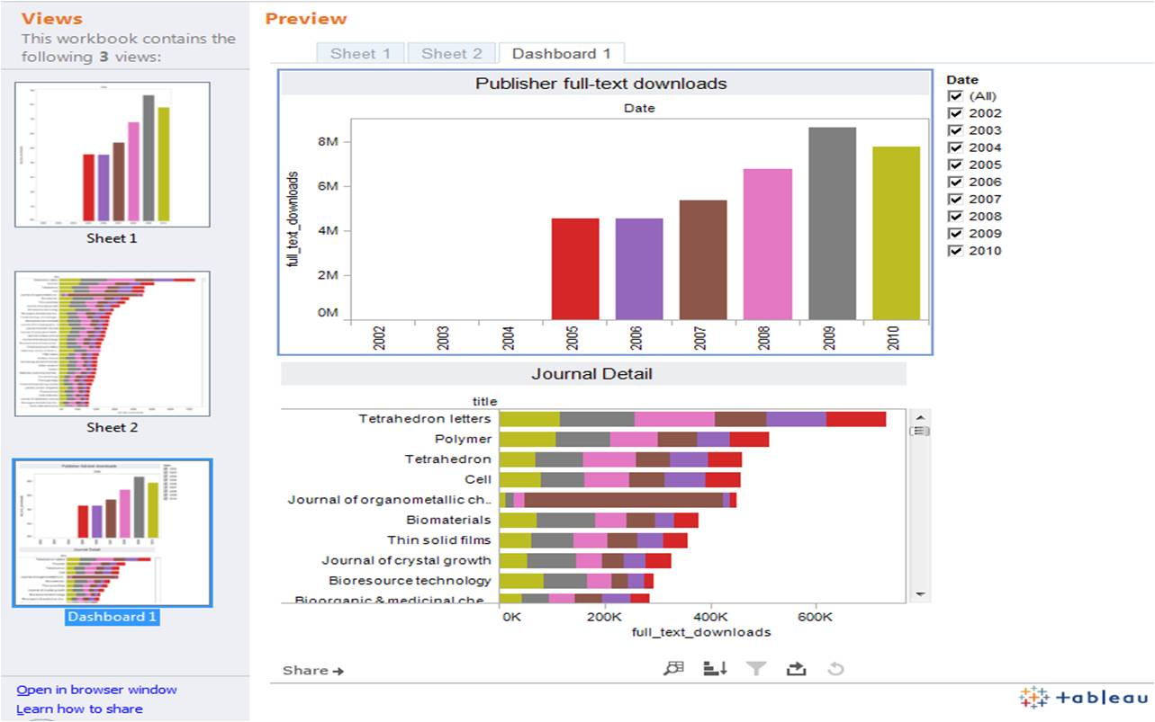
Collections as a Service
Textbooks and textbook alternatives
Text-mining tools
Demand-driven solutions
Data-informed collection strategies
Notes:
We like to think of our collections as a service so that we can ensure that our collections are responsive to the campus needs and so that we can connect users to diverse collections.
We’ve negotiated special rights for our researchers to conduct text mining across many of our archival collections
We use Demand-driven approaches to get more for our money and deliver more precise service to users. Just in time to complement Just in case.
To save student money and help create a sustainable textbook ecosystem, we purchase one copy of every required textbook for every course for students to use, and we pair that with our AltTextbook project for faculty to create free or low-cost alternatives to expensive textbooks.
We use Data-informed Collection Strategies where we integrate data about the use, access, and composition of our collections to understand how our collection is used, show return on investment, demonstrate our alignment with NC State needs, and improve the users’ experience. [82 cents cpu for journals+databases, targeted cluster support]

Slide 36
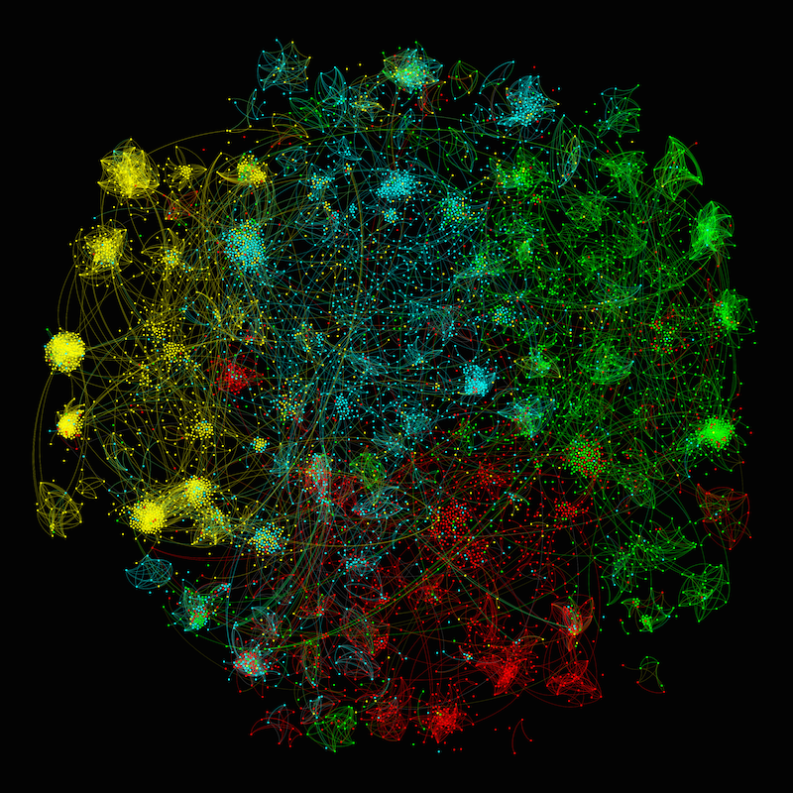
Amplifying Research & Scholarly Impact
Scholarly profiles
Data & software publication
Impact metrics, altmetrics, & citation analyses
Data Science & visualization tools
Public Science
Notes:
Shifting emphasis from the Libraries supporting the traditional products of scholarship more efficiently and re-investing that energy into the processes of scholarship and non-traditional outputs.

Slide 37
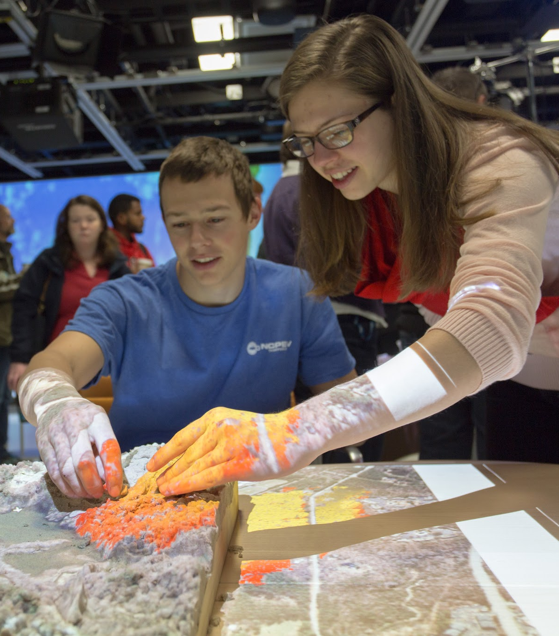
Broader Impacts Support
Writing stronger Broader Impacts statements
Assessing Broader Impacts
Budgeting for Broader Impacts
Campus Resources
https://www.lib.ncsu.edu/broader-impacts
Notes:
We have also worked with campus partners to create a hub for all things related to Broader Impacts from how to write Broader Impacts statements to assessment, budgeting, and all of the resources available to you across campus.
Partnerships to support research enterprise are untapped for their potential.
Office of Research & Innovation
Office of Faculty Development
Office of Information Technology.

Slide 38
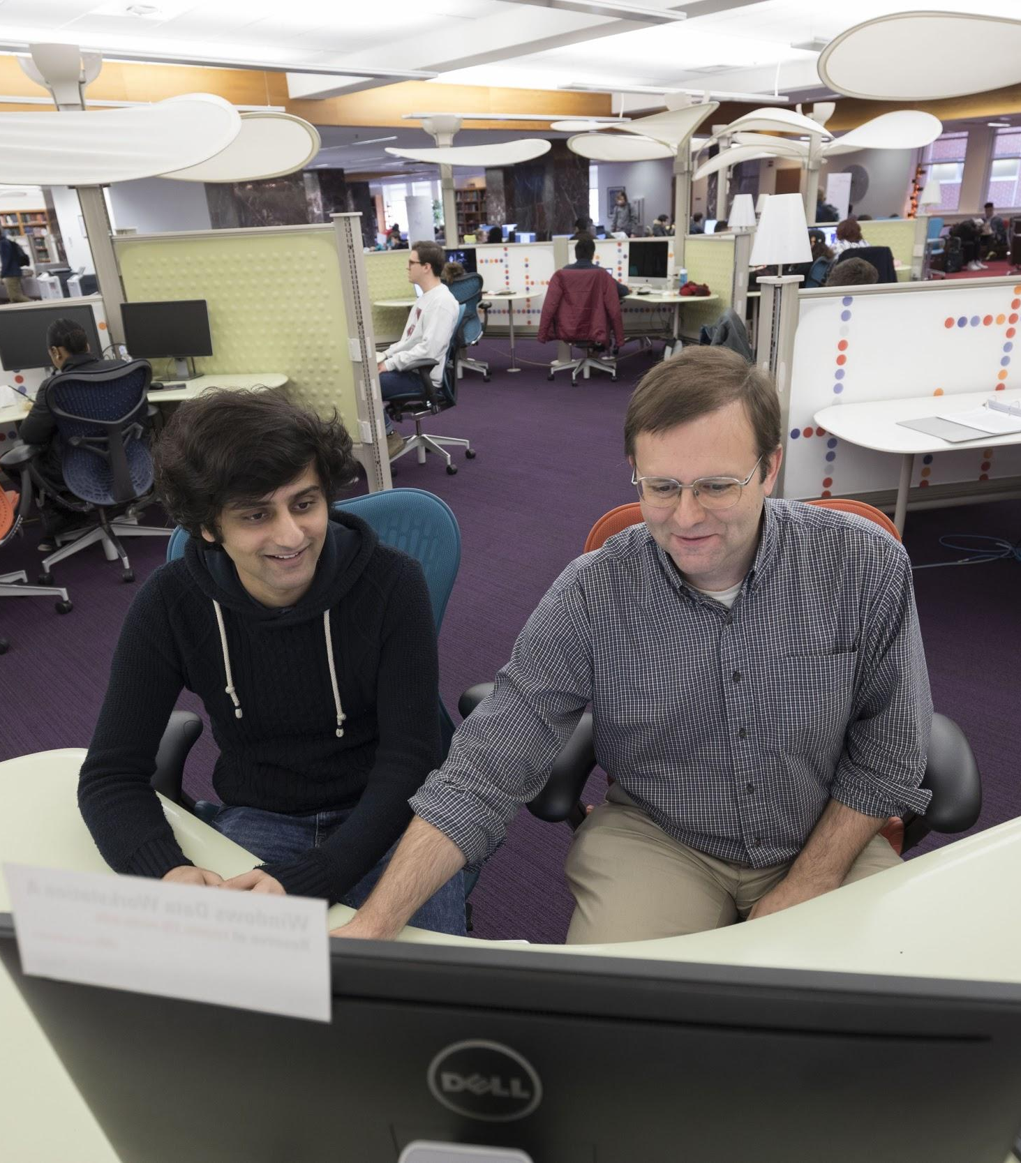
Research Data Services and Support
As of Dec. 2018, $8.1 million in awarded grants were supported by the Data Management Plan Review service.
37 different departments have used the DMP Review service.
At least 4 of these projects were DOE or NSF CAREER Award winners.
Notes:
We have also worked with campus partners to create a hub for all things related to Broader Impacts from how to write Broader Impacts statements to assessment, budgeting, and all of the resources available to you across campus.
Notable Partners:
OIT Shared Services
OIT Data Security
IRB
ORI
Research Support Council
PDU
Where & how do I store my data?
How do I share my publications and data?
How do I compile metadata for my data?
How can I comply with my funder’s requirements?
How do I manage my intellectual property and copyright?
Susan:
I have been working on and off for years to try to address the evolving needs of faculty regarding genomics/imaging data acquisition, analysis, storage, archiving as well as our institutional response to the ever-changing demands by Federal agencies for access to primary data generated by grant funding. I do this in part because I am interested, and also because I am responsible for all University Core Research Facilities (including the Genomic Sciences Laboratory (GSL) and the Cellular and Molecular Imaging Facility (CMIF)). Both facilities churn-out terabytes of data each year, and this volume seems to increase each and every day.
Our latest effort to try to get a handle on faculty needs involved a survey (results attached) focusing on software packages offered by NSF, as well as the computational and storage capacity of NC State’s High Performance Computing service (HPC). As part of this survey, a number of faculty brought up the issue of Federal access requirements and how the University intends to respond. This has been a sore point for some time and I wondered if you would be willing to meet with us to talk about how the University Libraries might be able to help.
A meeting has been scheduled to discuss the survey results on Friday, March 29th, from 11:45AM to 1:00PM in the Richard L. Daugherty Conference Room in the Poulton Innovation Center, 1021 Main Campus Drive. Please let me know if you are able to attend. If not, I will work to try to find another day/time that works for you.
Thanks.
Jon
Jonathan M. Horowitz, PhD
Professor of Cancer Biology
Assistant Vice Chancellor for Research
Office of Research and Innovation

Slide 39
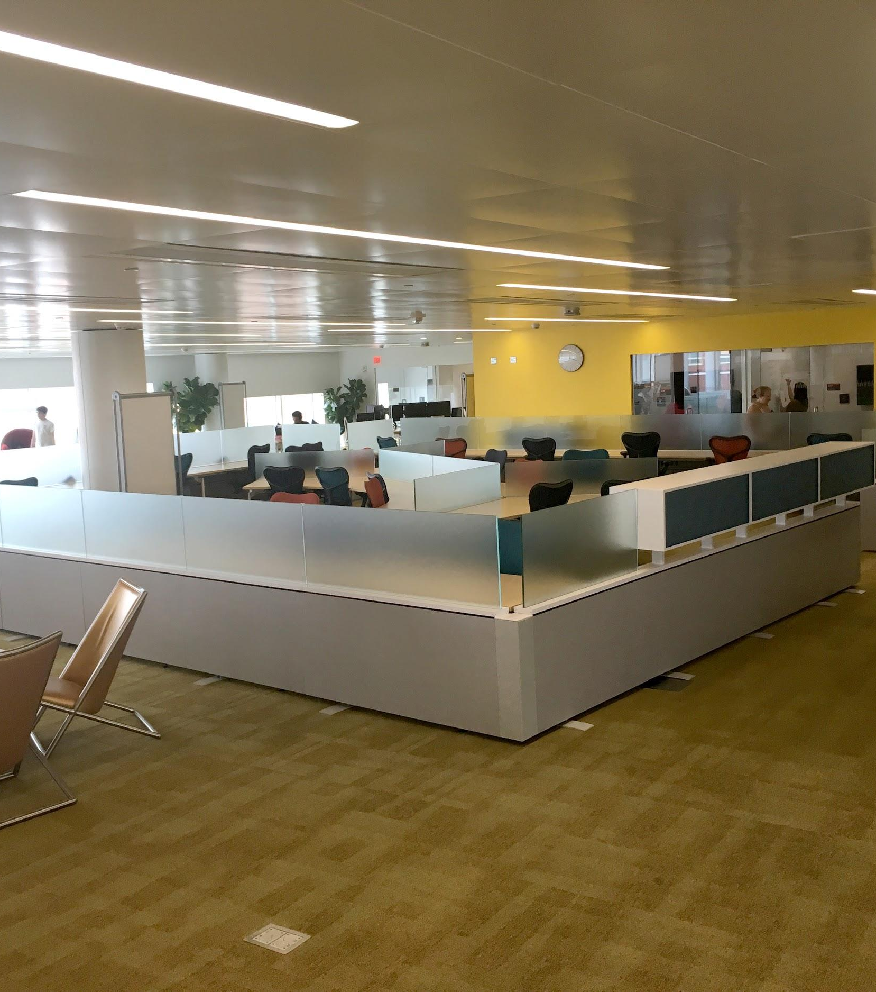
The Dataspace at the Hunt Library
A centralized space where students and researchers across disciplines can access specialized tools and technology, participate in workshops, and engage with experts
Staffed by graduate student Data Science Consultants with expertise in data topics and tools
Undergraduates make up 46% of user interactions, up 1300% compared to before the space opened.

Slide 40
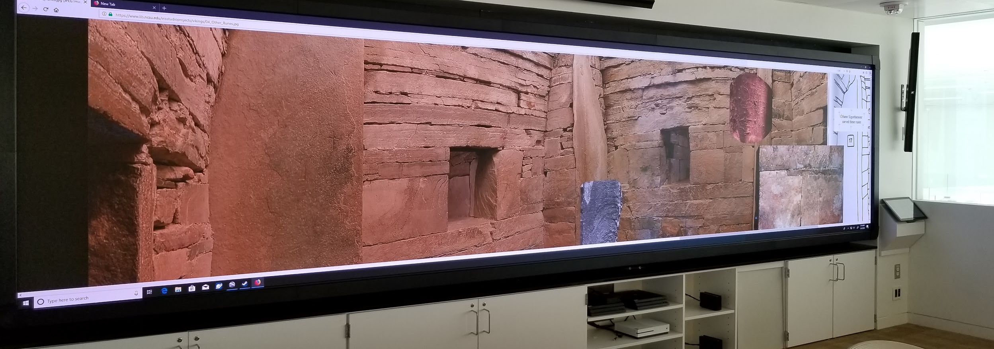
Refreshed Hunt Library Game Lab
Notes:
Taking it from a narrower gaming focused use emphasis to a broader array that includes gaming, data science, visualization, and an array of workshops. Privately funded by foundation. Hunt keeps connecting. Attracting private support to keep it at the top.
Privately funded
Refresh display technology
Remove console and add more flexible seating for workshops and instruction
Retain infrastructure to support gaming research
Improve interactivity of the screen to encourage hands-on data exploration
Proximity of the lab to the Dataspace makes it convenient to attend a workshop, then continue work on a project on the adjacent workstations.

Slide 41
Librarians as Catalysts in the Research Process
Data Science & Research Computing
Public Science &
ORCID
Lab & Curricular Integration
OERs &
Content Mining
RDM &
Research Admin Partnerships
Bibliometrics &
Public Access Compliance
Digital & Immersive Scholarship
Entrepreneurship &
Data Literacy
Grad Student & Post-Doc Partnerships

Slide 42
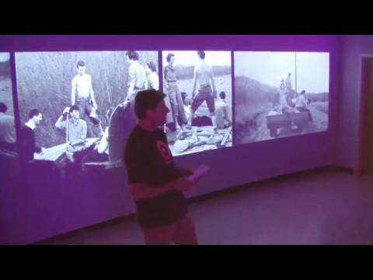
Notes:
David Silver’s THE FARM AT BLACK MOUNTAIN COLLEGE
Data science
Data visualization
Copyright
Digital scholarship
Digital humanities
Research data management
Metadata
Machine learning
Natural language processing
Software development tools and techniques
Digital media production
Makerspaces
Virtual and augmented reality

Slide 43
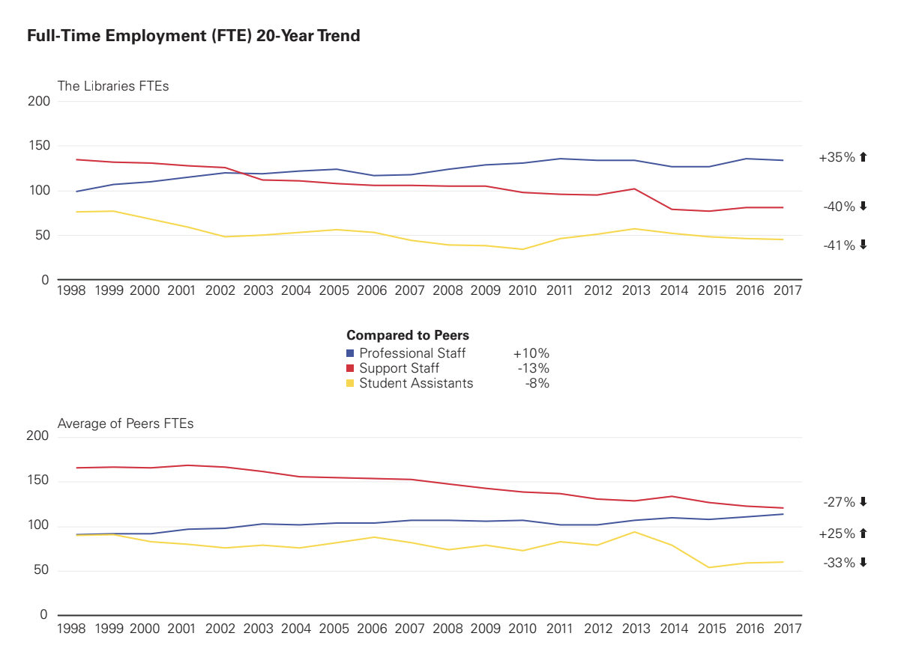

Slide 44
A Gateway to the Community
Notes:
If you build it, it doesn’t necessarily mean that they’ll come on their own.
We develop extensive programming, outreach, and communications to inform and engage the campus community and the public with our spaces, services, and resources.

Slide 45
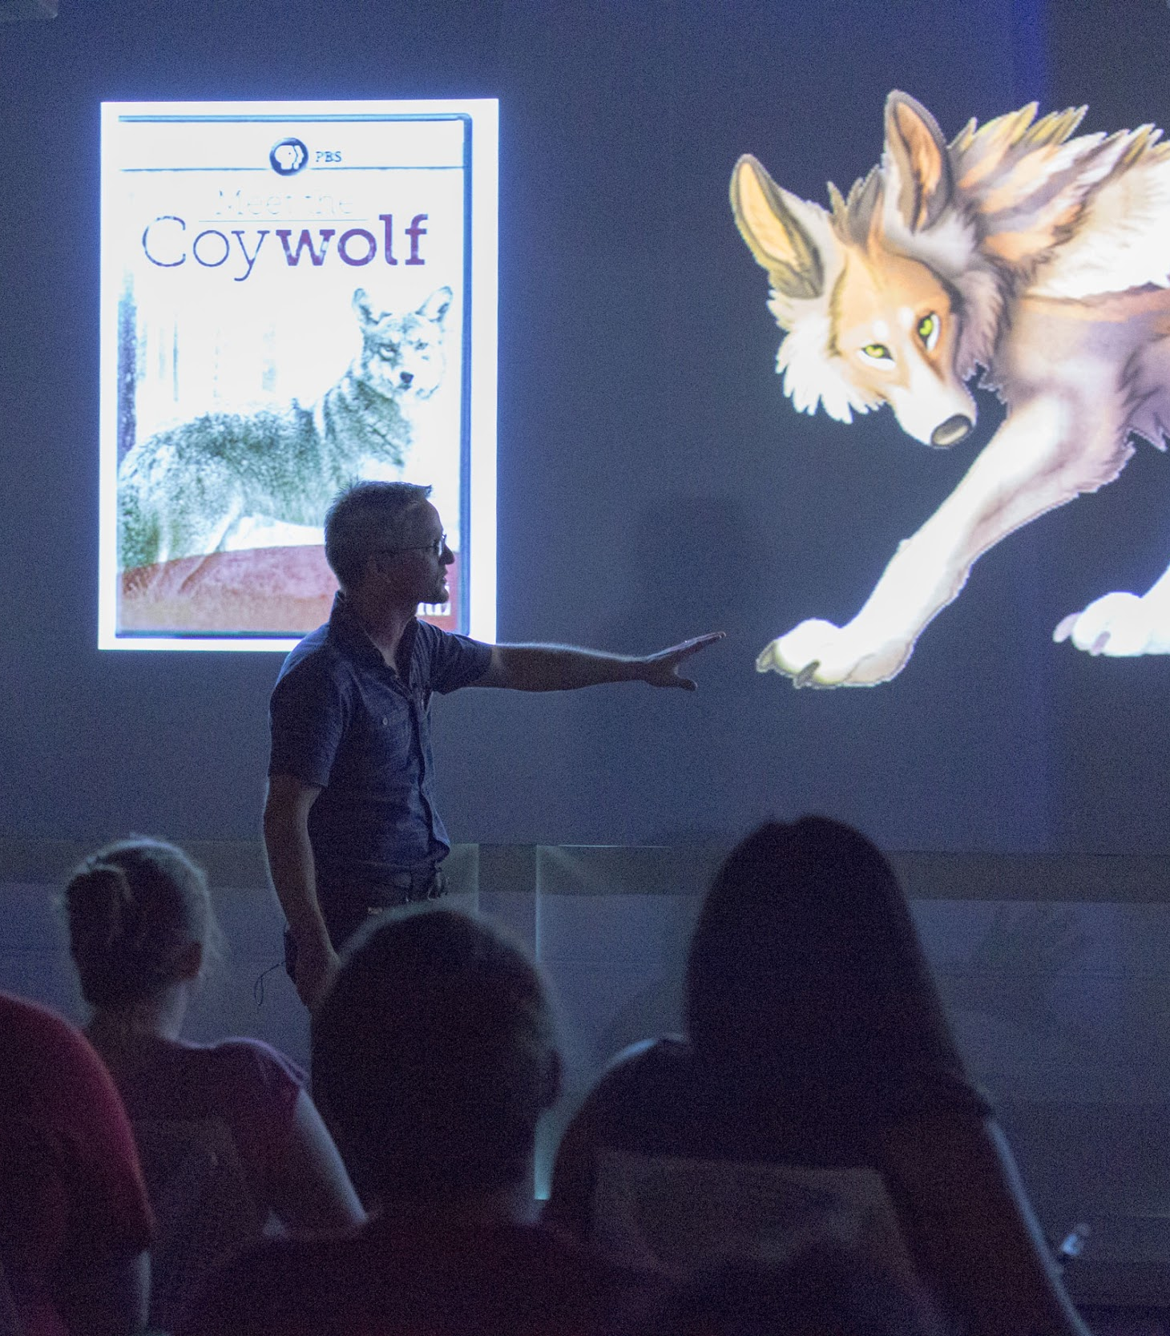
Programming and Outreach
~9,000 attendees in 2018
97 programs in 2018
Up 424% over the last five years

Slide 46
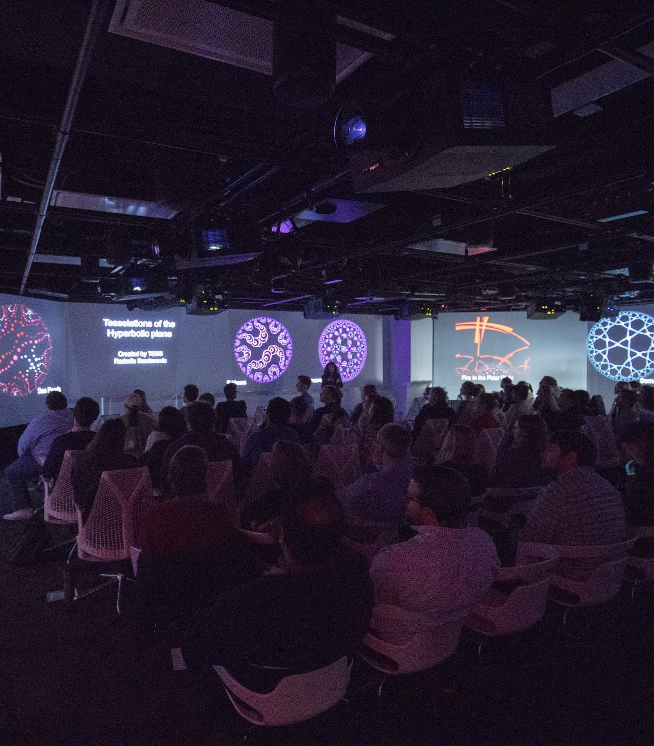
Coffee & Viz
Forum for NC State researchers to share their visualization work and discuss topics of interest
Presented by the Libraries in one of our state-of-the-art high-tech spaces like the Teaching & Visualization Lab
Coffee & Viz programs are free and open to the public
NC State Visualization Interest Group

Slide 47
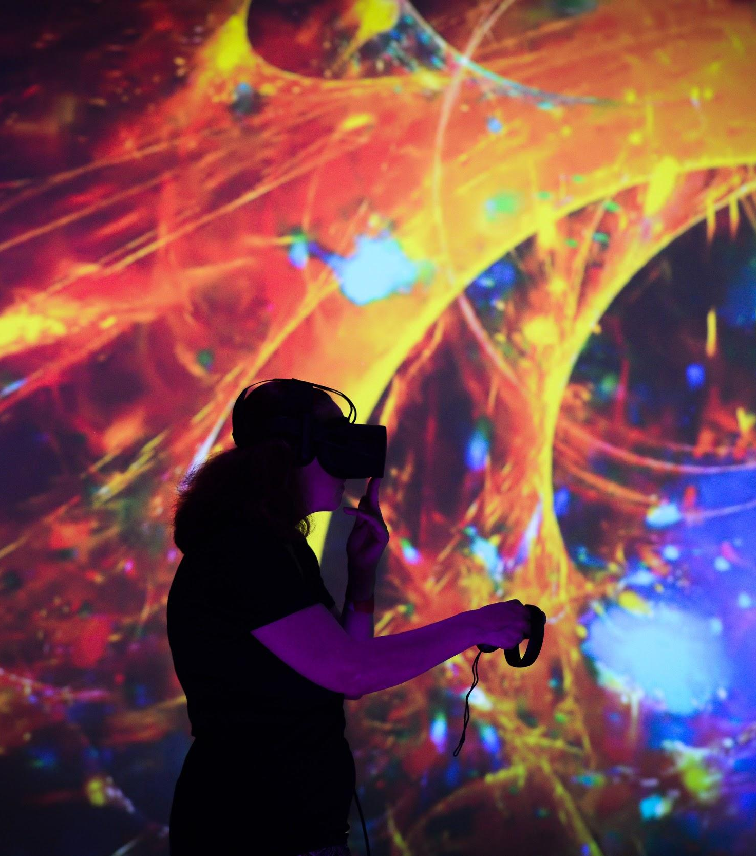
State of the Sciences LIVE at the Library
A collaboration with the College of Sciences
800+ community attendees
Attendees engaged with research principles, methods, and tools, such as virtual reality technology.

Slide 48
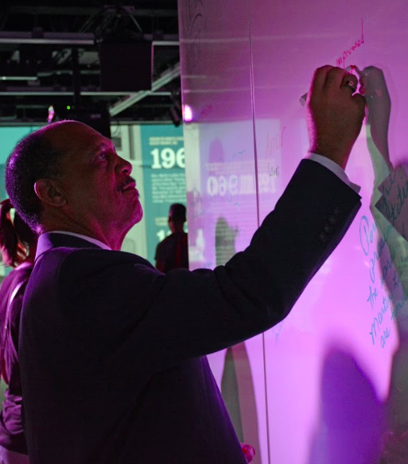
Experiencing King
Dr. Martin Luther King’s impact was experienced and understood anew at NC State University through a series of public events.
A performance by renowned actors Danny Glover and Felix Justice—as Dr. King and Harlem Renaissance poet Langston Hughes
An immersive experience at the James B. Hunt Jr. Library showcasing three innovative projects by Dr. Jason Miller and Dr. Victoria Gallagher
Conversation with Pulitzer Prize-winner David Garrow and art work by Synthia SAINT JAMES

Slide 49
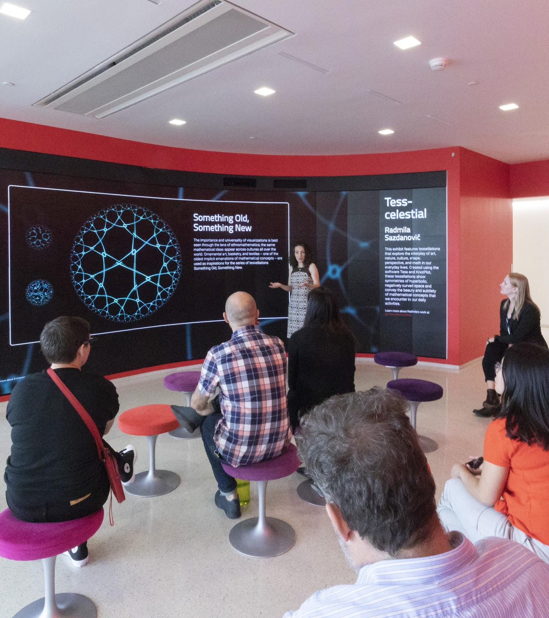
Exhibits: Showcasing Student and Faculty Work
Physical and digital platforms
Hill Library Gallery and Hunt Library video walls
Hunt Library Tech Showcase and Hill Library Innovation Studio
Providing a platform for students and faculty to engage public and academic audiences
Enhancing competitiveness of grant proposals
Demonstrating value of research and higher education to the public

Slide 50
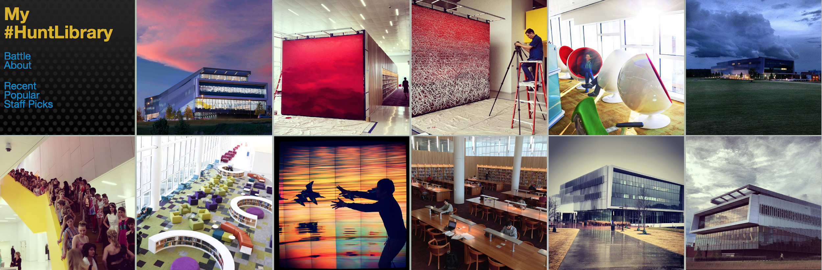
Raising the Profile of NC State
Notes:
Engaging campus in showcasing what the Libraries offers via initiatives like My #HuntLibrary

Slide 51
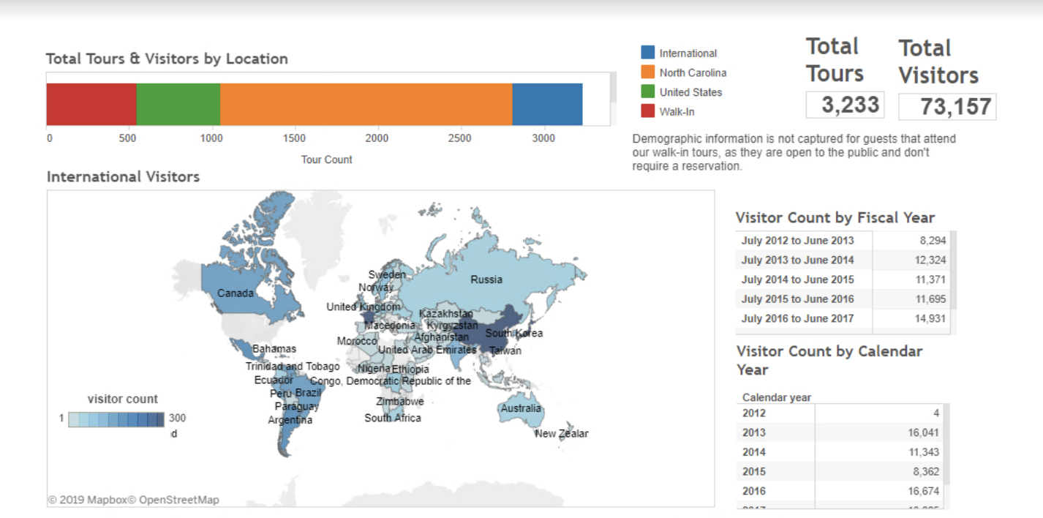
Bringing the World to NC State
Notes:
Visitors from all over the world come to see the Libraries, including high-level administrators from all sectors.

Slide 52
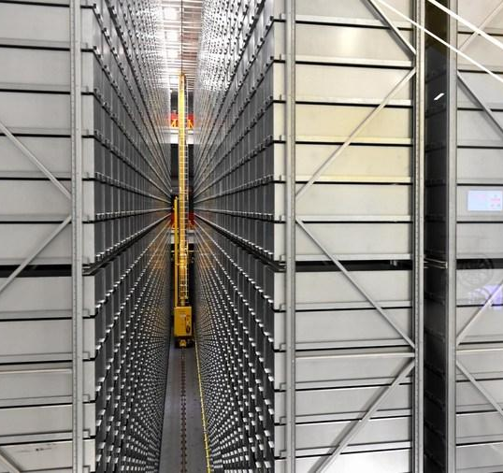
“The bookBot at N.C. State’s Hunt Library is hands down the coolest thing I saw during my visit.”
— Melanie D.G. Kaplan, Jan. 16, 2019
“You’re going where? Raleigh.”
Notes:
The Libraries have been featured in/on the Washington Post, the Wall Street Journal, Time Magazine, the Boston Globe, NPR, CNN, MSNBC, USA Today, all of the major local affiliates and major print media sources, every major library, architecture, and higher ed publication

