Slide 1
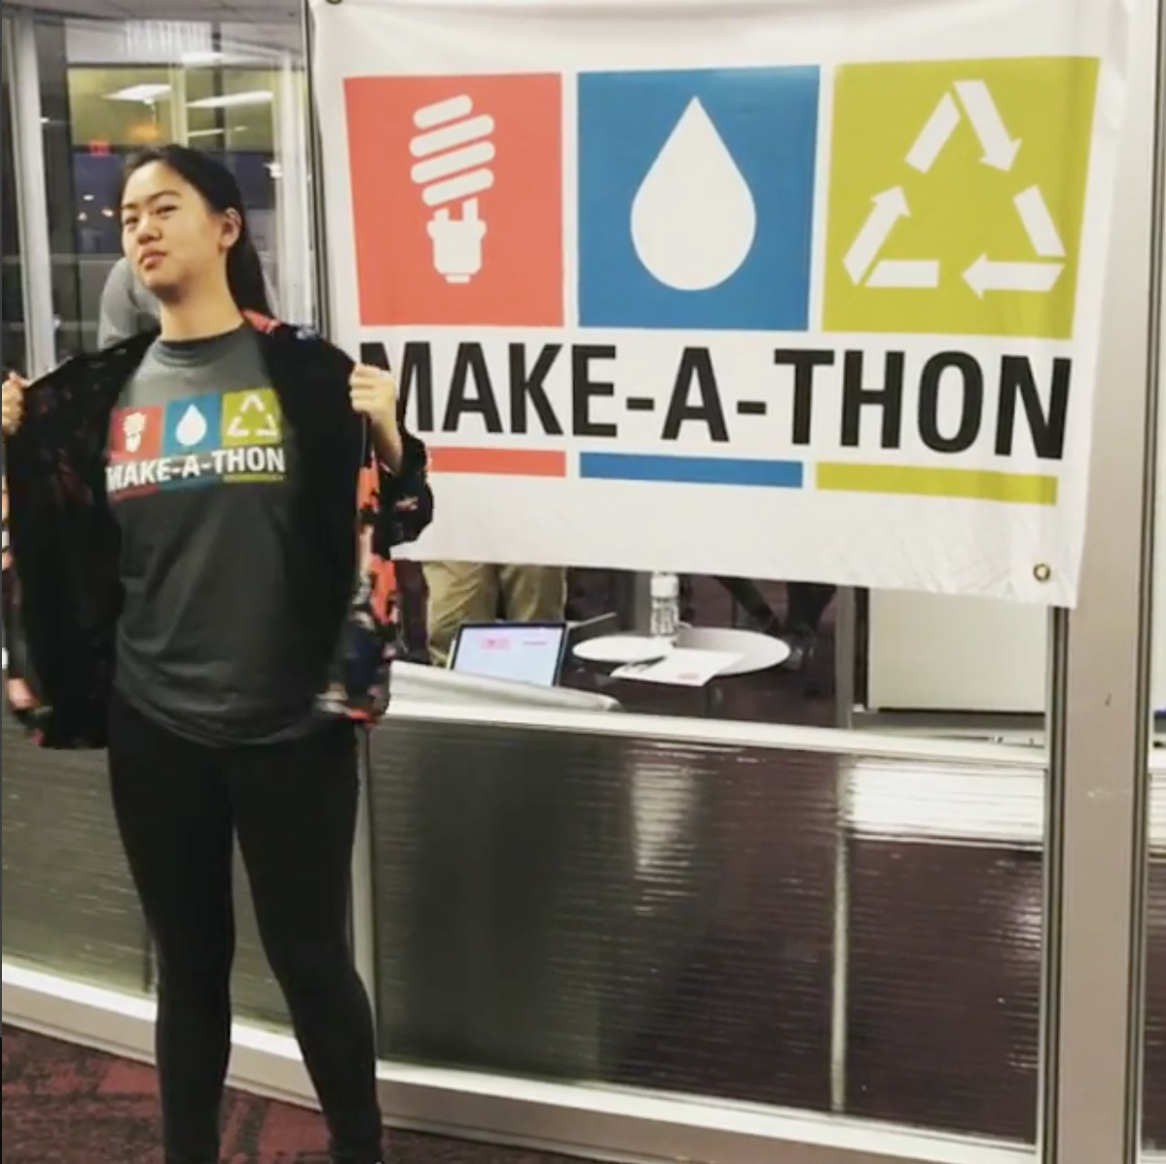
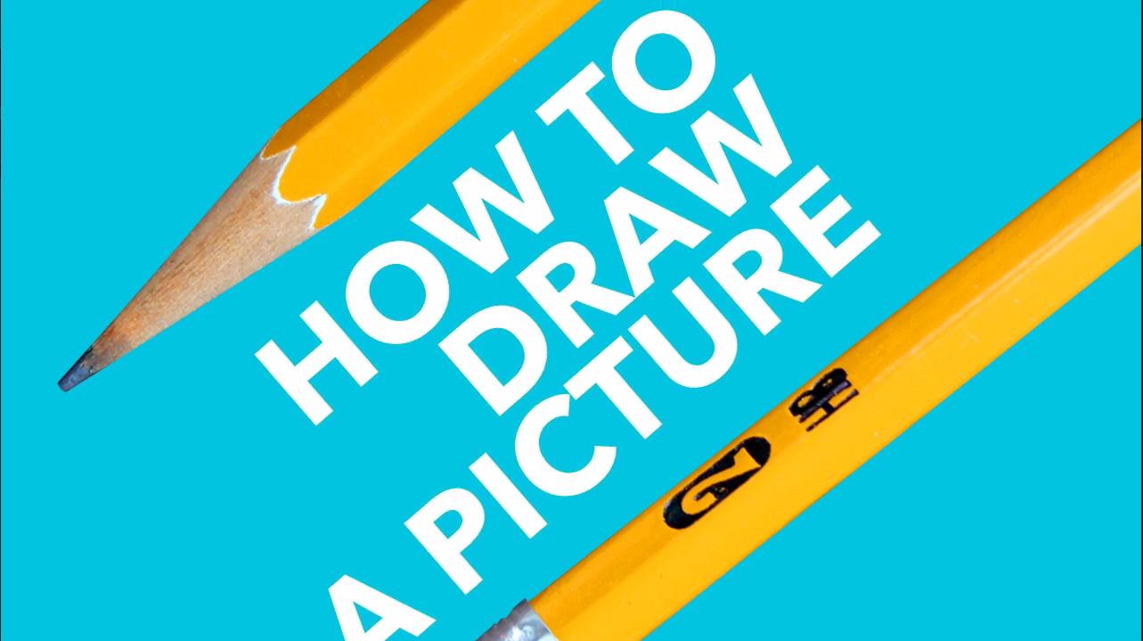
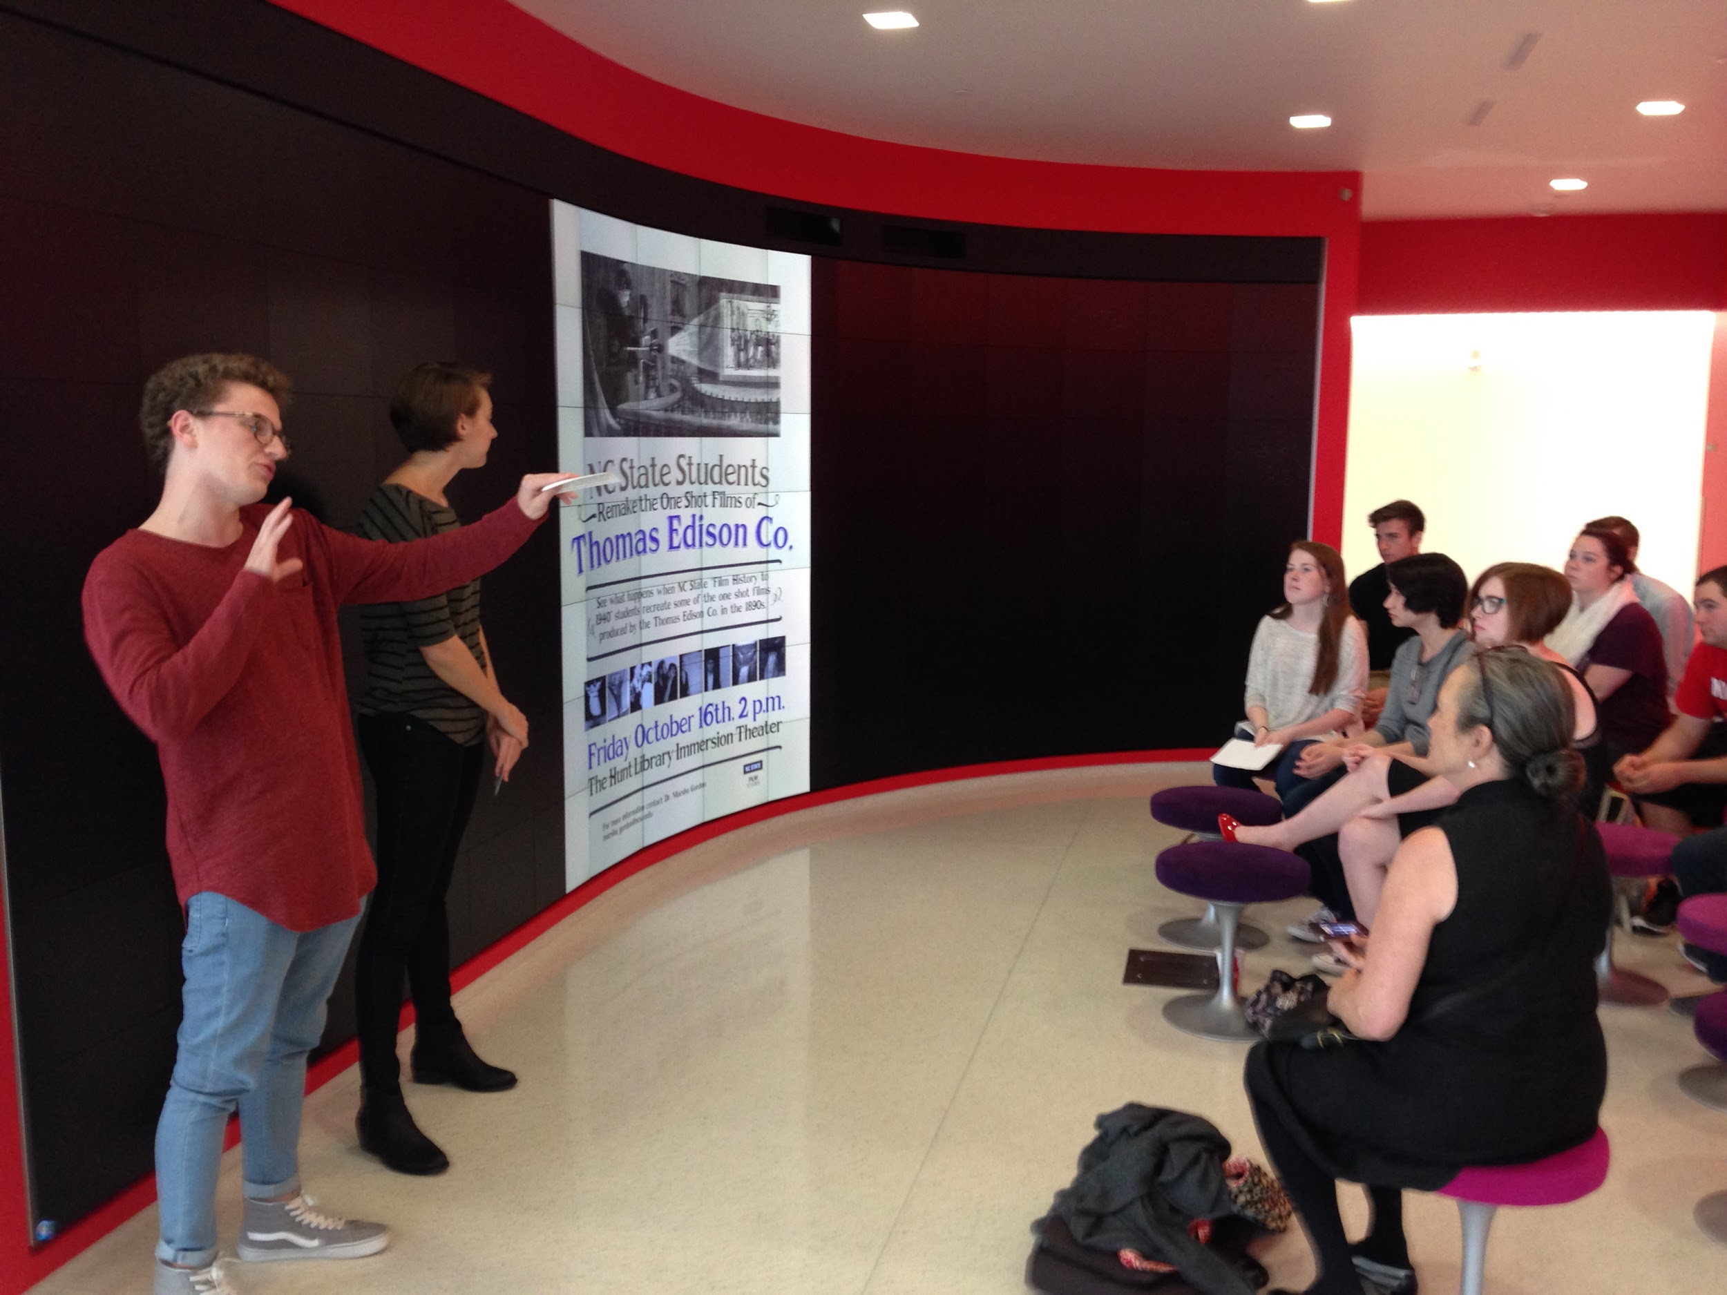
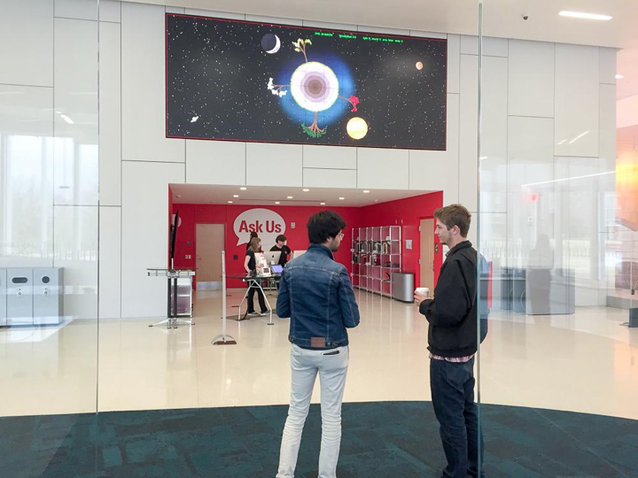
Showcasing Student Work
at the Libraries
Jason Evans Groth
—————————————--
Digital Media Librarian
—————————————--
Learning Spaces and Services
Thought Bubble by icon 54 from the Noun Project
Notes:
Email me with questions!
jevansg@ncsu.edu

Slide 2
Scholarship in the Sandbox: Academic Libraries as Laboratories, Forums, and Archives for Student Work Association of College and Research Libraries (2018)
“Articulating the Value of Student Works: Case Studies from the NCSU Libraries”
Will Cross Jason Evans Groth Marian Fragola Lillian Rigling Mira Waller

Slide 3
“Articulating the Value of Student Works: Case Studies from the NCSU Libraries”
“Fulfilling the Promise—and the Inspiration—of High-Tech Spaces”
Jason Evans Groth

Slide 4
VISION
“...to be a place not of the past but of the future, a place where our students, faculty, and partners can gather to research, learn, experiment, collaborate, and strengthen NC State’s long tradition of leading transformative change.”

Slide 5
VISION
“A great research library is more than collections, technologies, and comfortable workspaces--a great library inspires. Its architecture and technology create spaces that encourage collaboration, reflection, creativity, and awe.”

Slide 6
VISION
“... destination for those who seek to explore how collaborative spaces and innovative applications of technology can inspire the next generation of engineers, designers, scientists, researchers, and humanists.”

Slide 7
VISION
EXPERIMENT
COLLABORATE
INNOVATE CREATE
INSPIRE

Slide 8
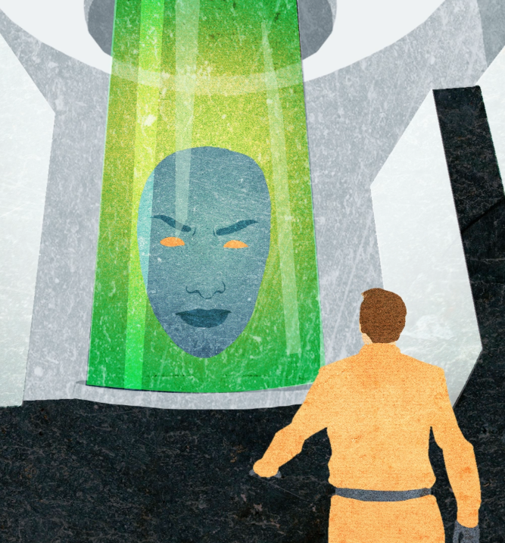
STUDENT SHORT FILM SHOWCASE
Notes:
Started in 2011 by Marian Fragola and then-libraries fellows Adam Rogers and Mike Nutt
Collaboration with Art + Design
CHASS and film production
CHASS and video production
Marc Russo, Jim Alchediak, Sarah Stein

Slide 9
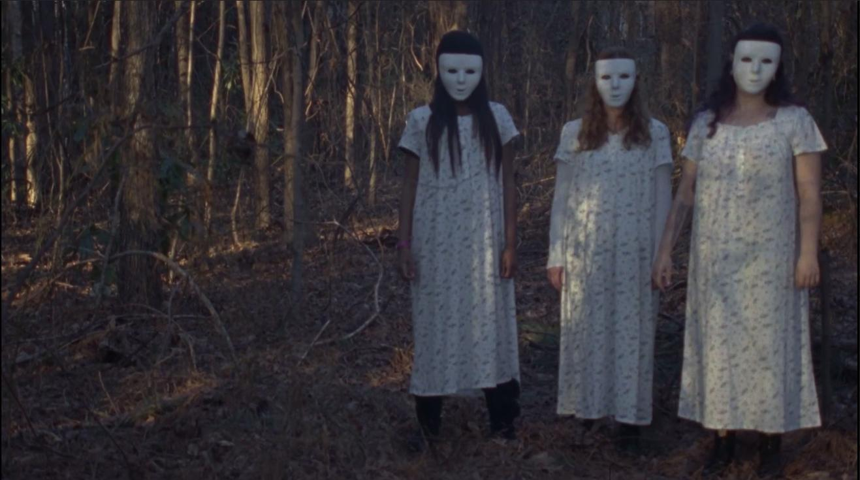
STUDENT SHORT FILM SHOWCASE

Slide 10
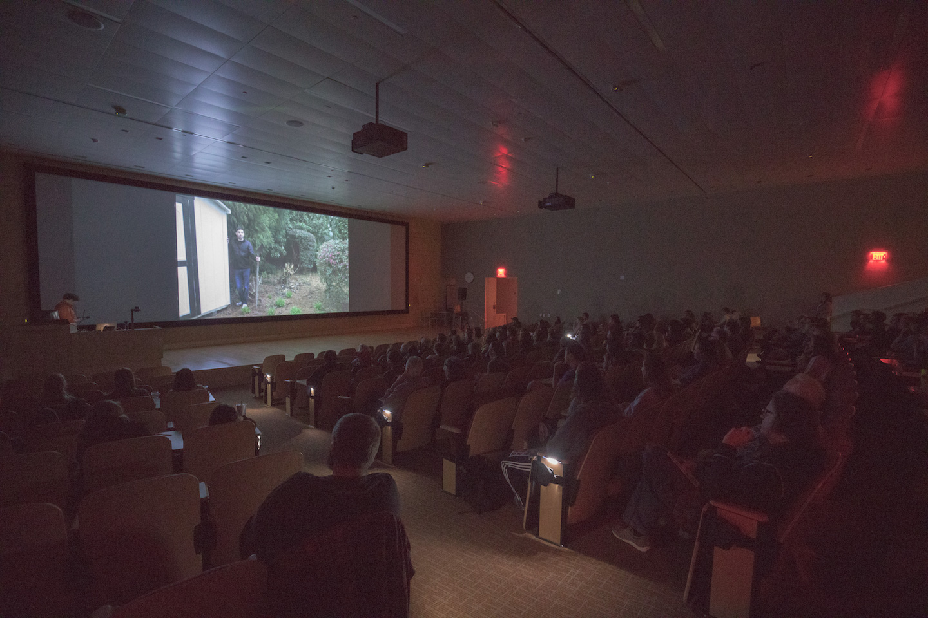
STUDENT SHORT FILM SHOWCASE

Slide 11
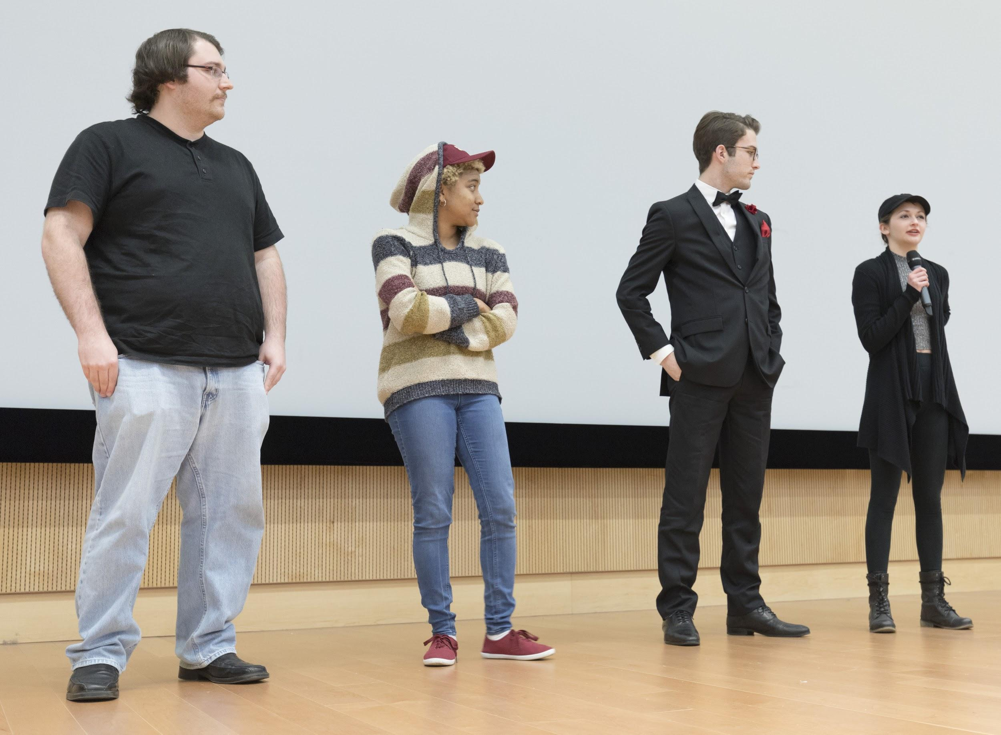
STUDENT SHORT FILM SHOWCASE

Slide 12
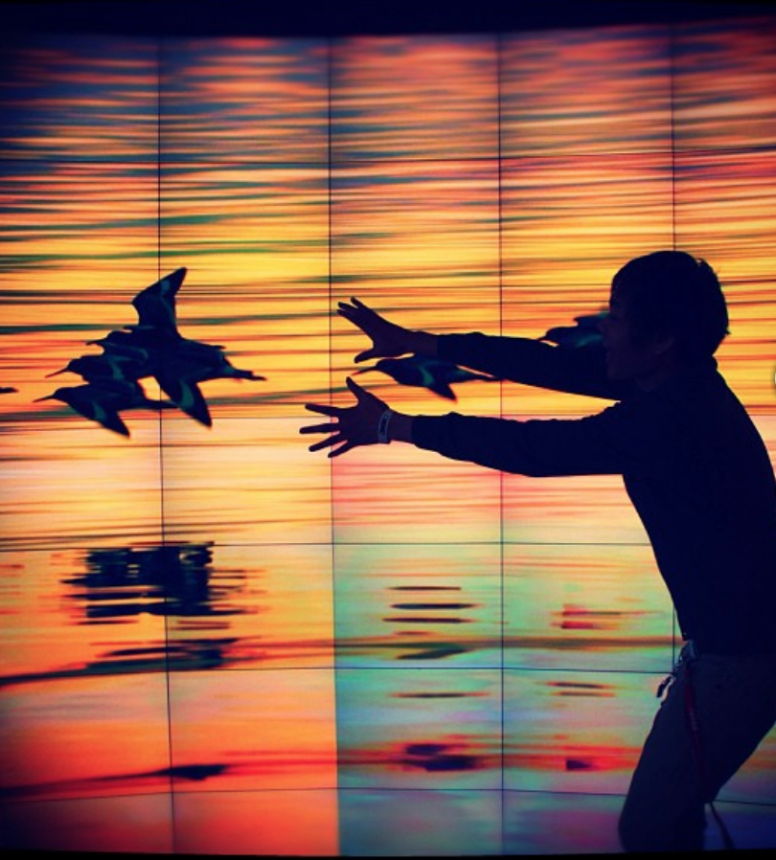
My #HuntLibrary

Slide 13
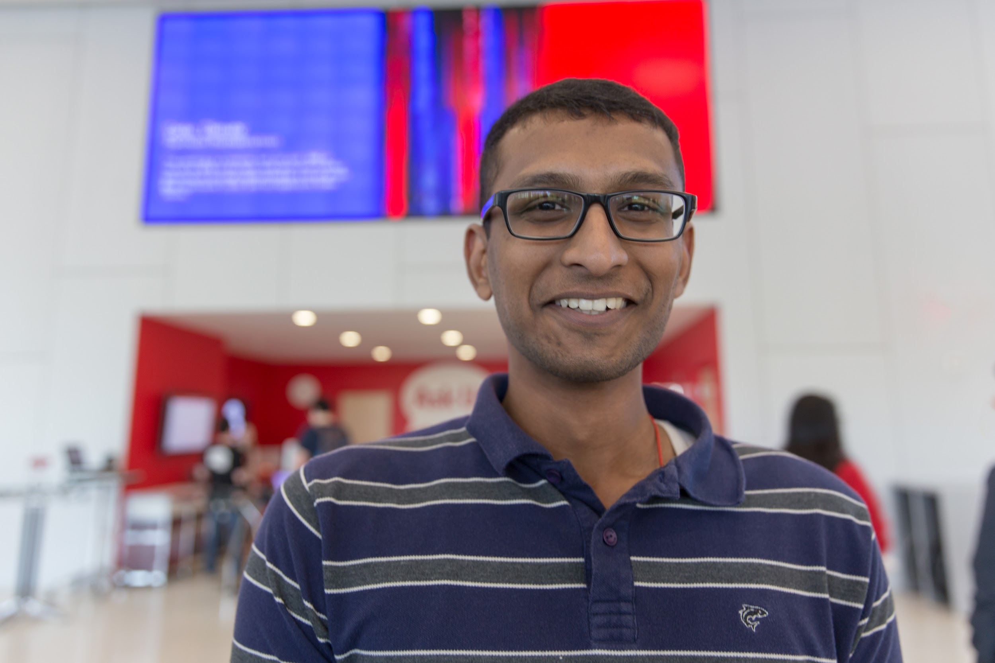
CODE + ART

Slide 14
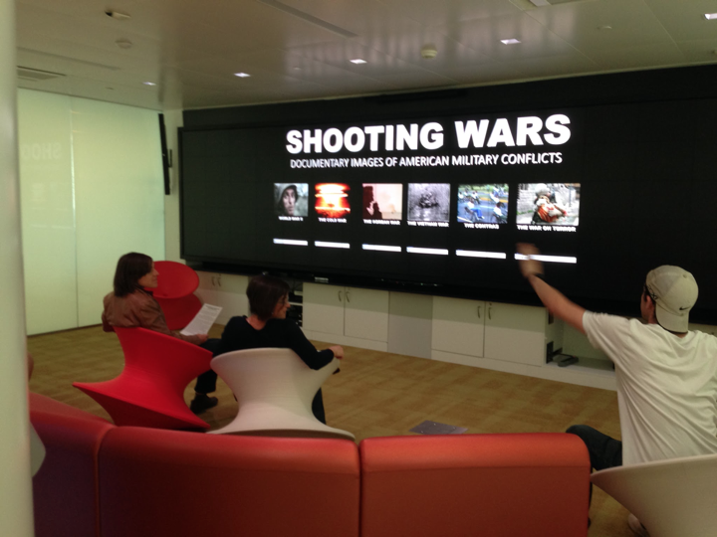
GAME LAB PROJECTS

Slide 15
IMMERSION THEATER PROJECTS

Slide 16
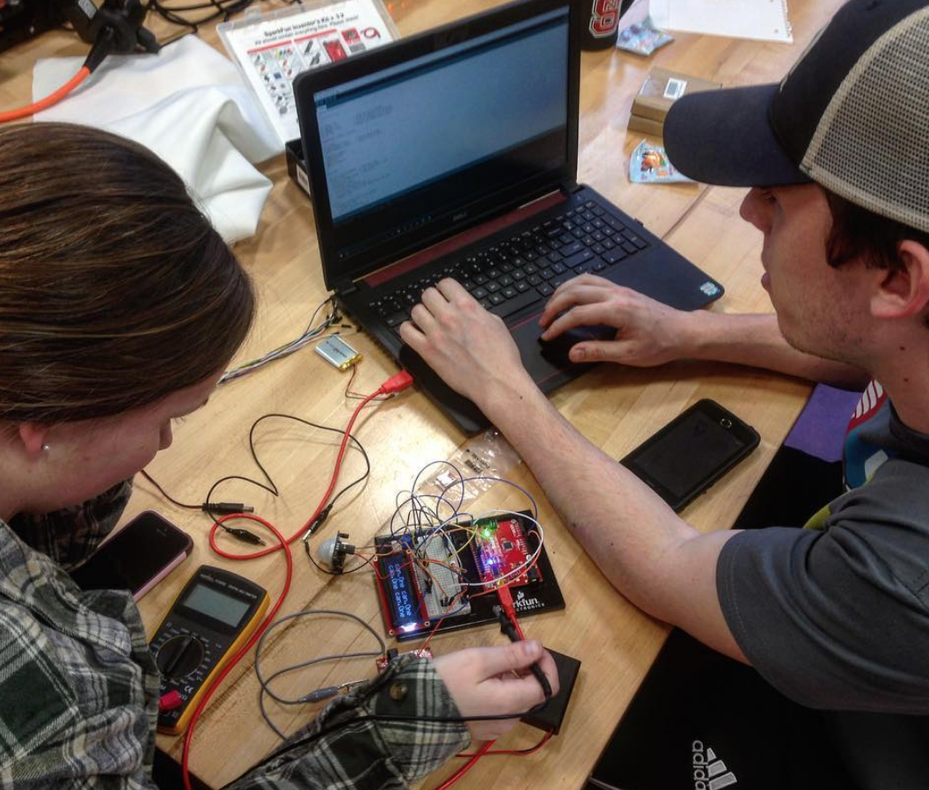
#ncsumakes

Slide 17
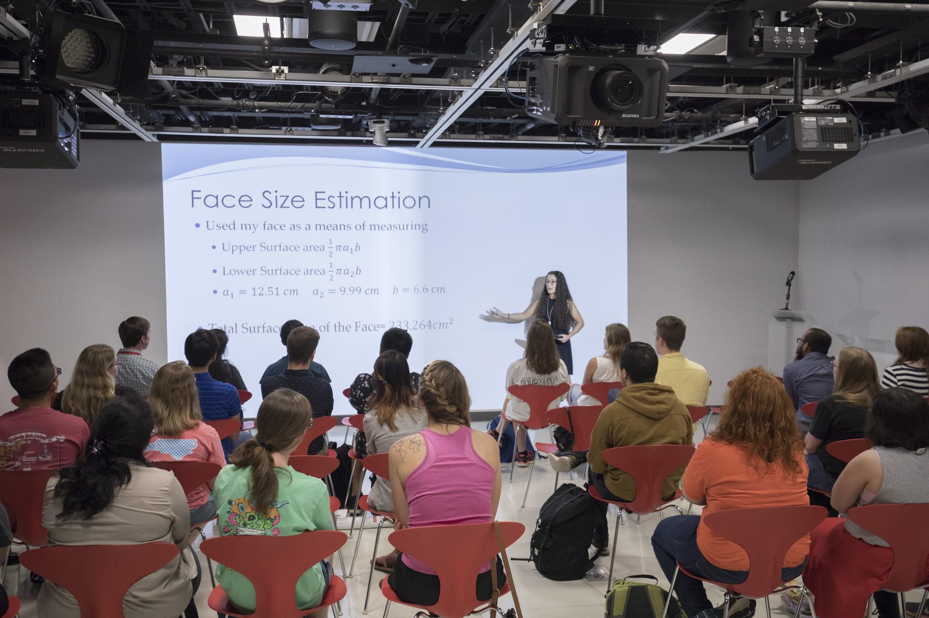
UNDERGRADUATE RESEARCH SLAM

Slide 18
STATE OF SOUND

Slide 19
INNOVATION STUDIO EXAMPLES
ARt in Augmented Reality Art exhibit of Design students' 3D models viewable in AR via Snapchat Lens
Student GIS work Large touchscreen display of interactive maps made by students in GIS course Wolf Tales
Viewing/listening station for browsing recorded Wolf Tales interviews State of Sound Interactive “jukebox” of recordings made in Music Booths/Rooms/by NC State students

