Slide 1
Wolf Tales:
Documenting Voices of Diversity at NC State
Virginia Ferris
Outreach and Engagement Program Librarian
Special Collections Research Center

Slide 2
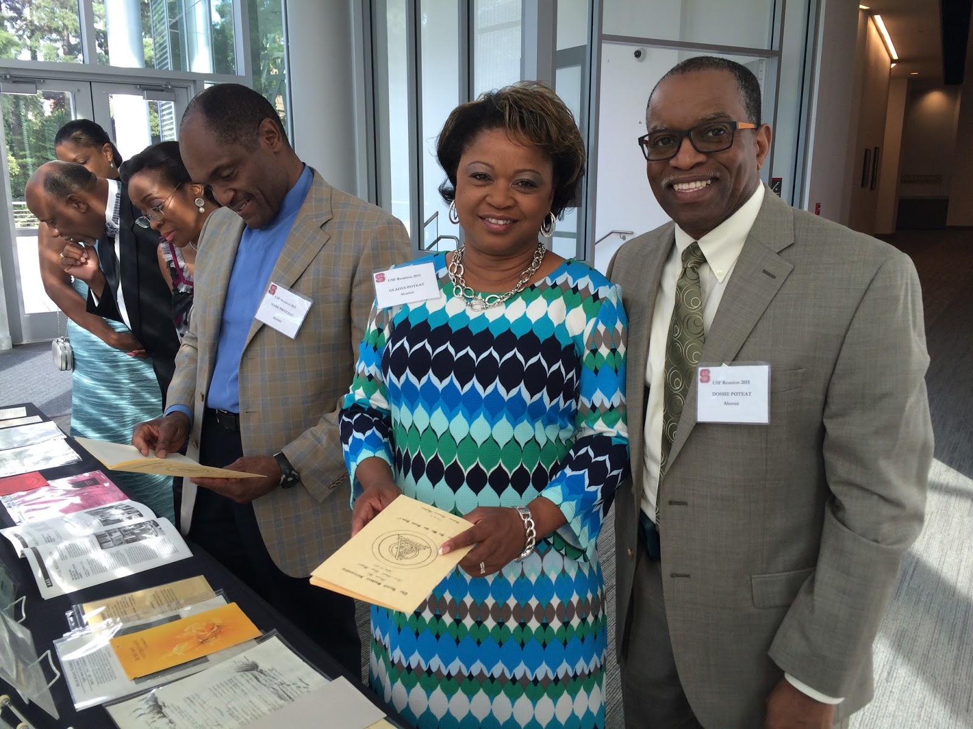
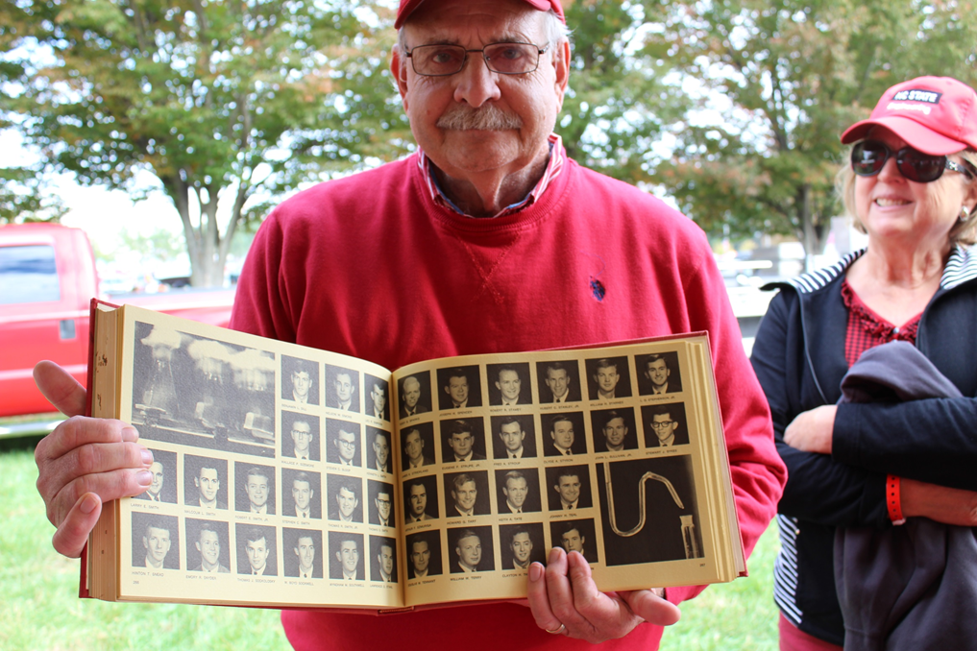
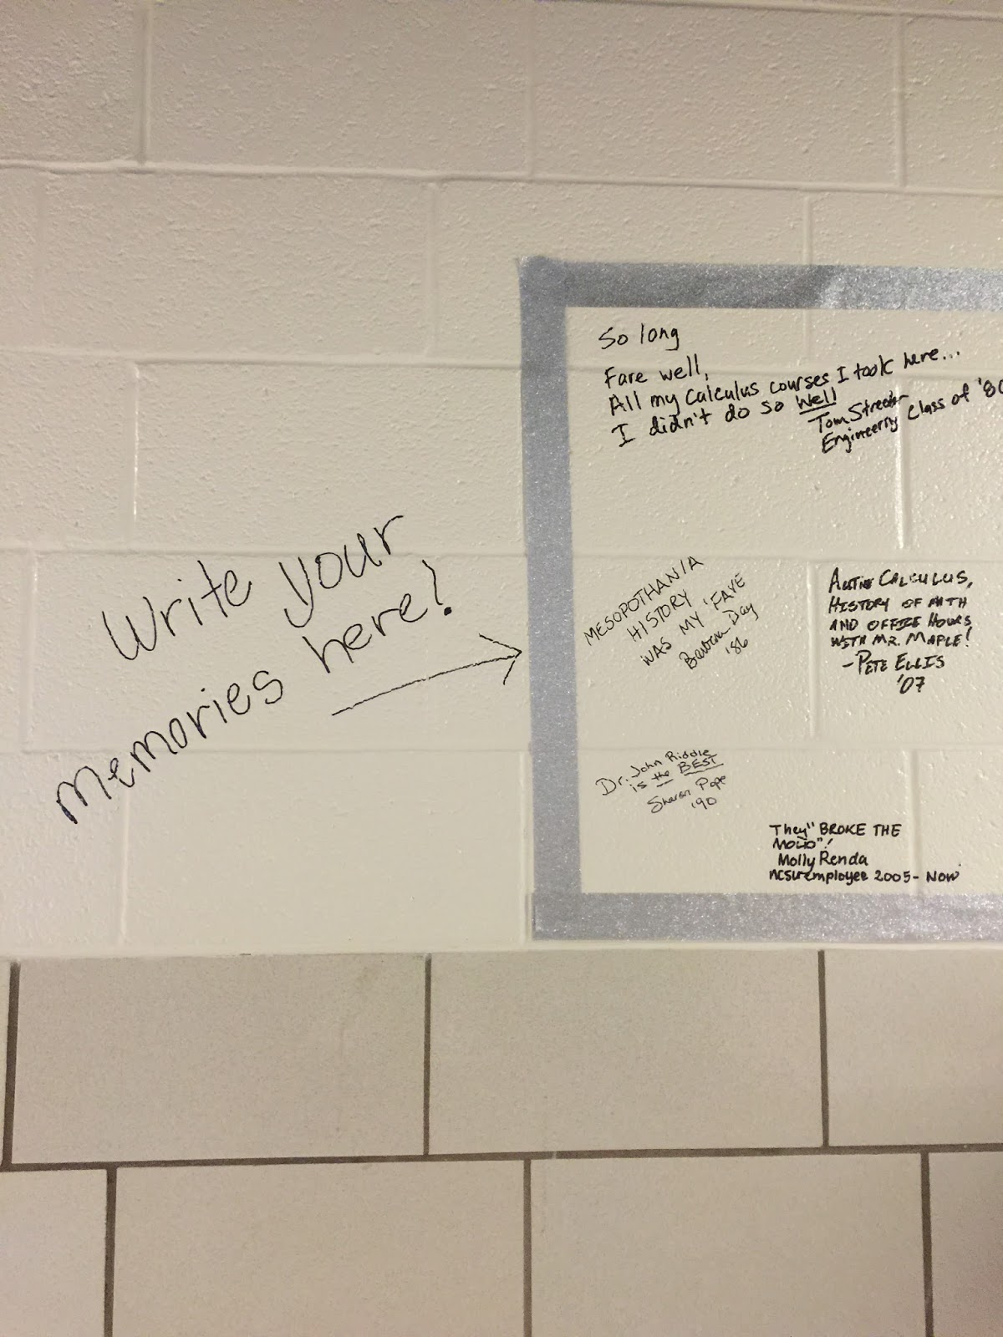
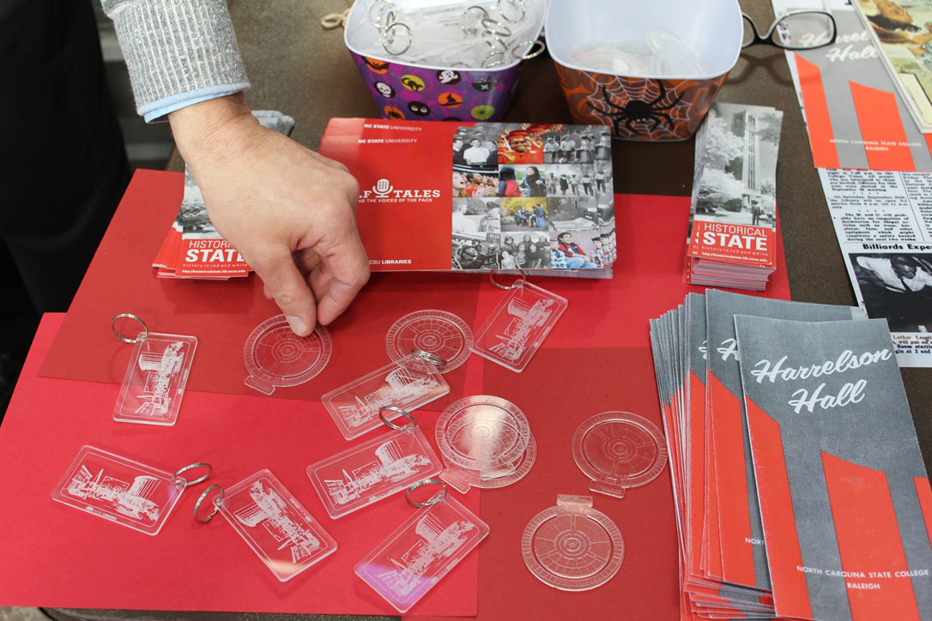
Notes:
Wolf Tales as a product of Special Collections outreach, especially outreach to alumni – show and tells at alumni events led to sharing stories not documented anywhere else in the archives – decided to create a way to add these stories to the official historical record.

Slide 3
Wolf Tales
Launched in July 2015
Short video recordings
Focus on documenting historically under-represented voices in the campus community
Notes:
Launched Wolf Tales mobile storytelling program in fall 2015, with support from an NCSU Libraries Good Ideas Grant.
Mobile – travel to bring recording stations to different locations on campus (including a booth setup in Libraries spaces)
Short video recordings – usually between 5-20 minutes – allows higher volume of recordings, includes more voices

Slide 4
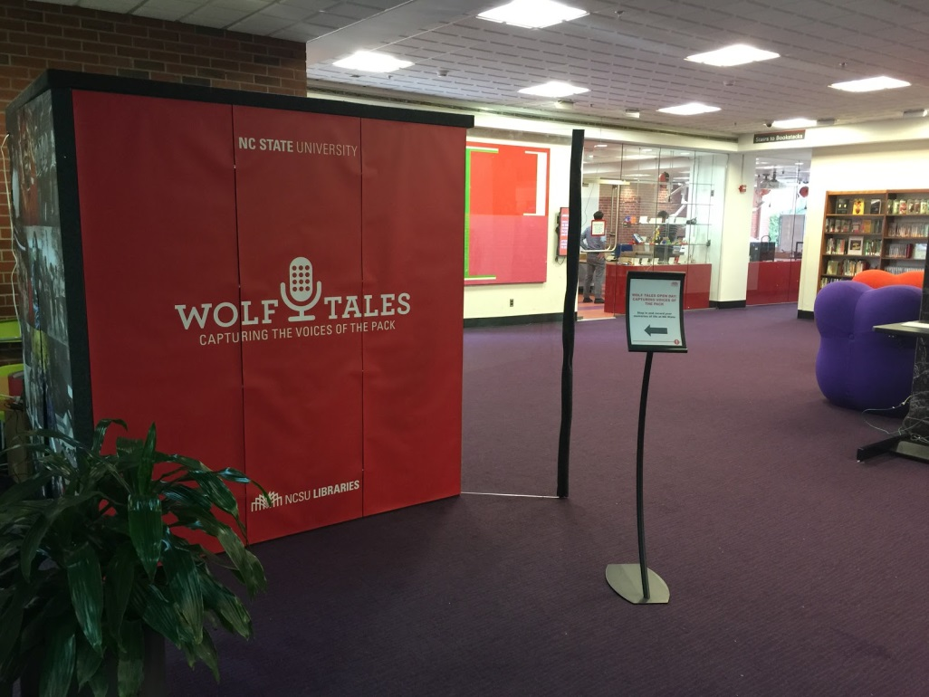
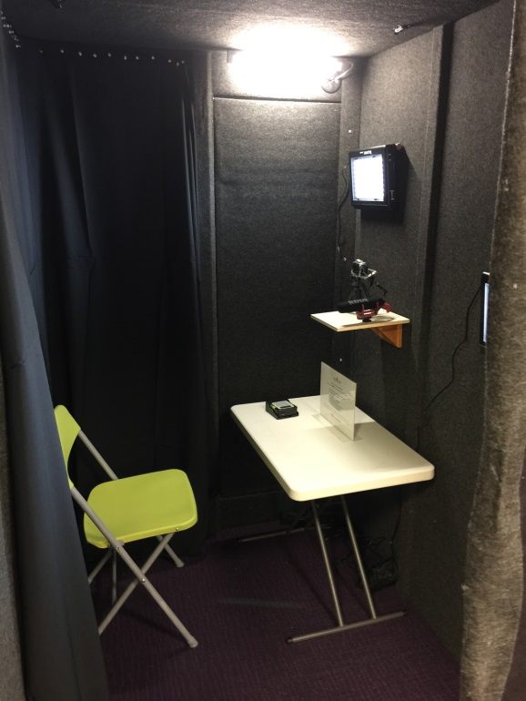
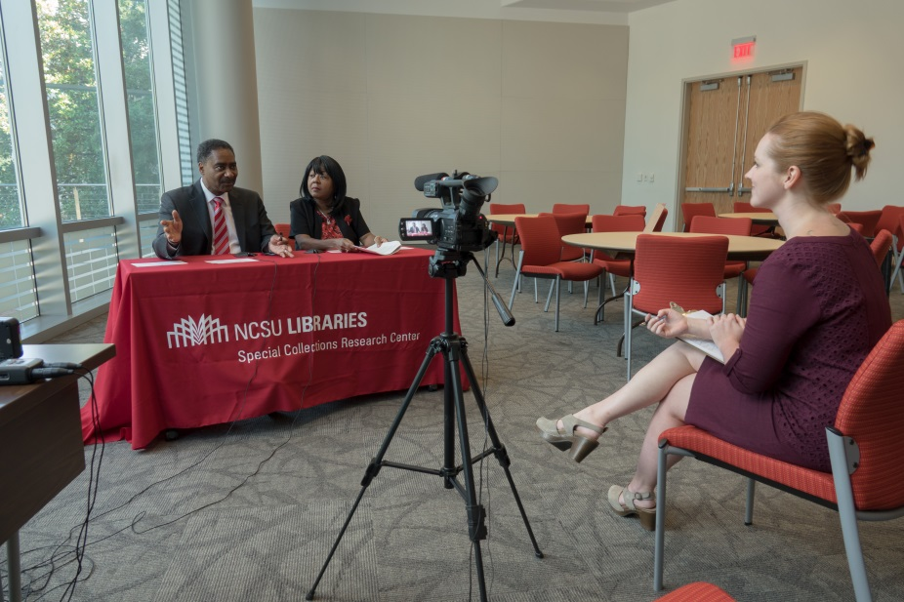
Wolf Tales
Launched in July 2015
Short video recordings
Focus on documenting historically under-represented voices in the campus community
Notes:
Launched Wolf Tales mobile storytelling program in fall 2015, with support from an NCSU Libraries Good Ideas Grant.
CAPTURING stories
Mobile – travel to bring recording stations to different locations on campus (including a booth setup in Libraries spaces)
Short video recordings – usually between 5-20 minutes – allows higher volume of recordings, includes more voices
Sometimes facilitated by an interviewer, but more often not – instead, provide participant with written questions or prompts and let them share what they wish
Individuals or groups (2-3 people usually) can participate in a recording together – opportunity for friends, couples, mentors/mentees, etc. to record together
Verbal and written communication of rights in release form
Shorter time length (vs. longform oral history interviews) gives more flexibility - allows us to collect more stories from a wider array of people, creating a more diverse and inclusive picture of the campus community.
The act of listening and preserving these stories strengthens participants’ connection to the archives and NCSU Libraries, and enriches the university’s historical record.

Slide 5
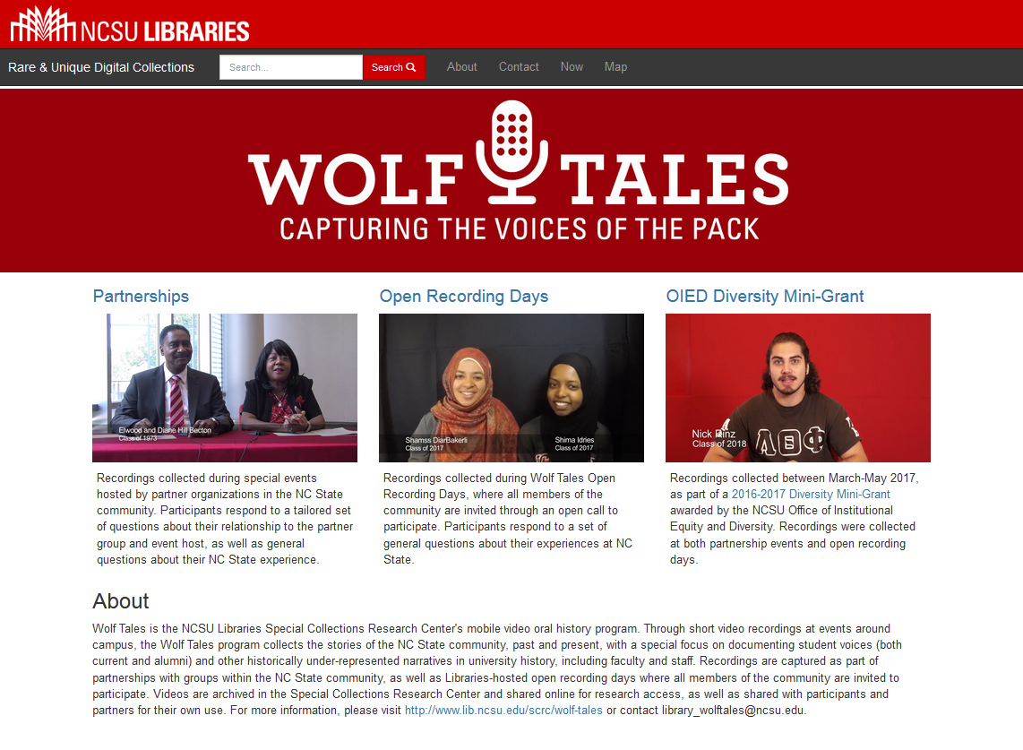
Notes:
SHARING stories
Recordings are added to our digital collections and are shared with participants and partner groups
(Splash page – can demonstrate)
Partnerships vs. open recording days
Evolution of partnerships – initially Alumni Association, then broadened to other groups – African American Cultural Center, GLBT Center – led to receiving a 2016-2017 OIED Diversity Mini-Grant
Continually expanding network with new partners, and establishing recurring partnerships for annual events – GLBT Center; Association of Women Faculty; Military and Veteran Resource Center; Black Alumni Society
Open recording days
OIED Diversity Mini-Grant – allowed us to broaden network and deepen relationships with groups on campus – gain greater awareness and participation

Slide 6
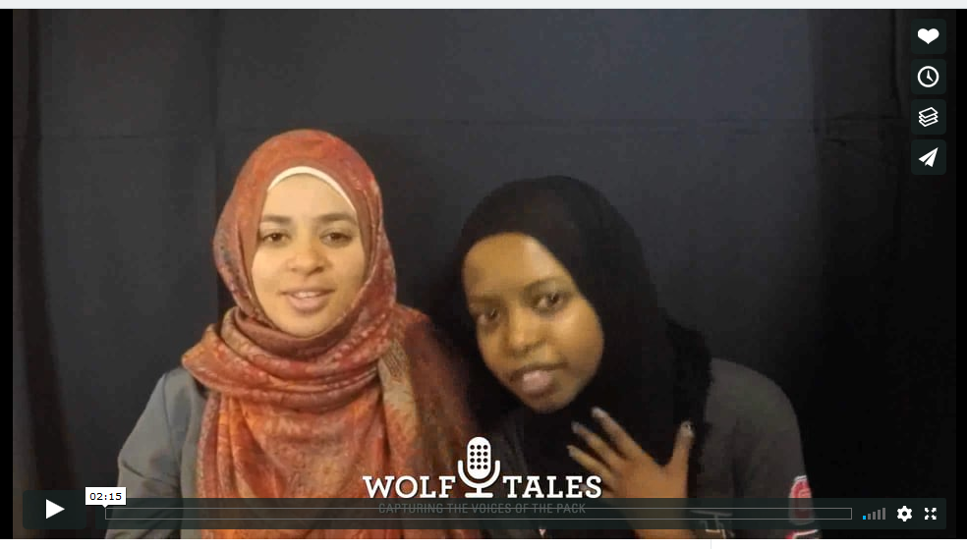
Building visibility and participation
Notes:
[click image to play promo video on Vimeo]
Promo video developed to help bring more visibility and familiarity with the program

Slide 7
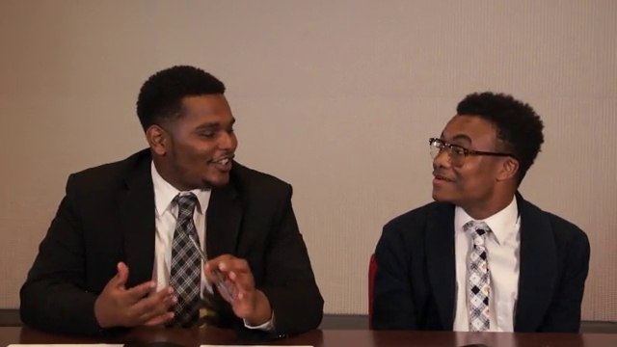
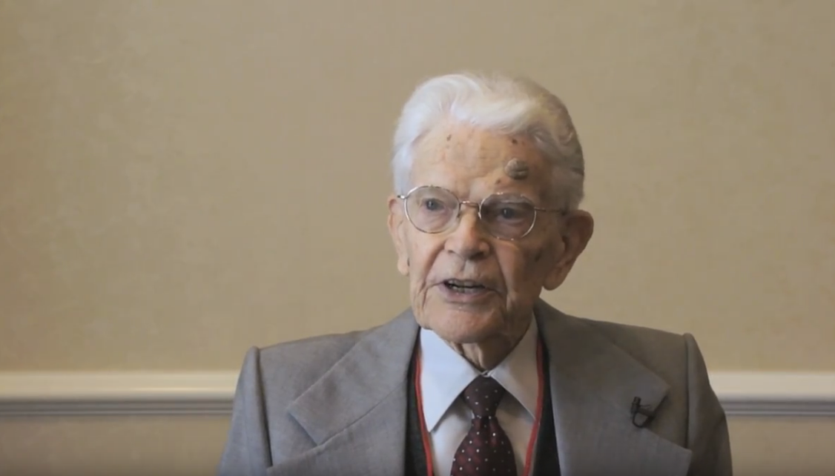
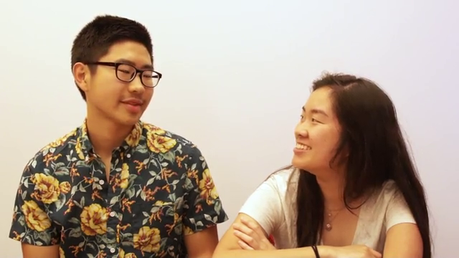
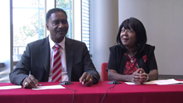
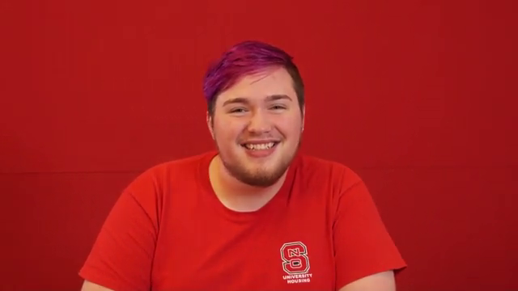
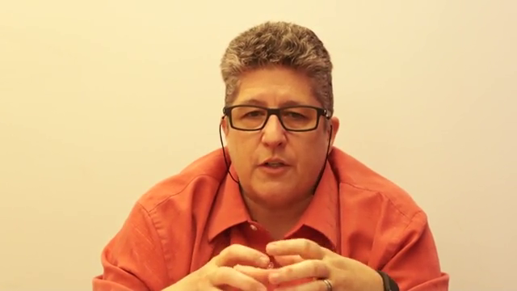
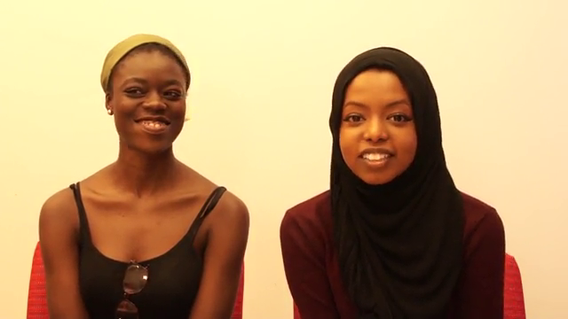
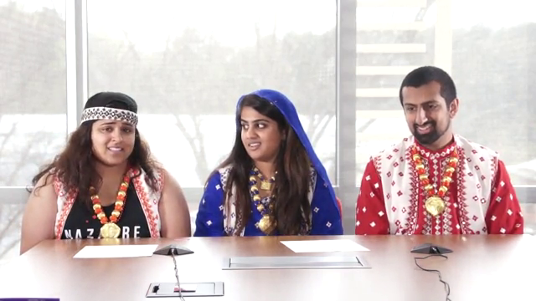
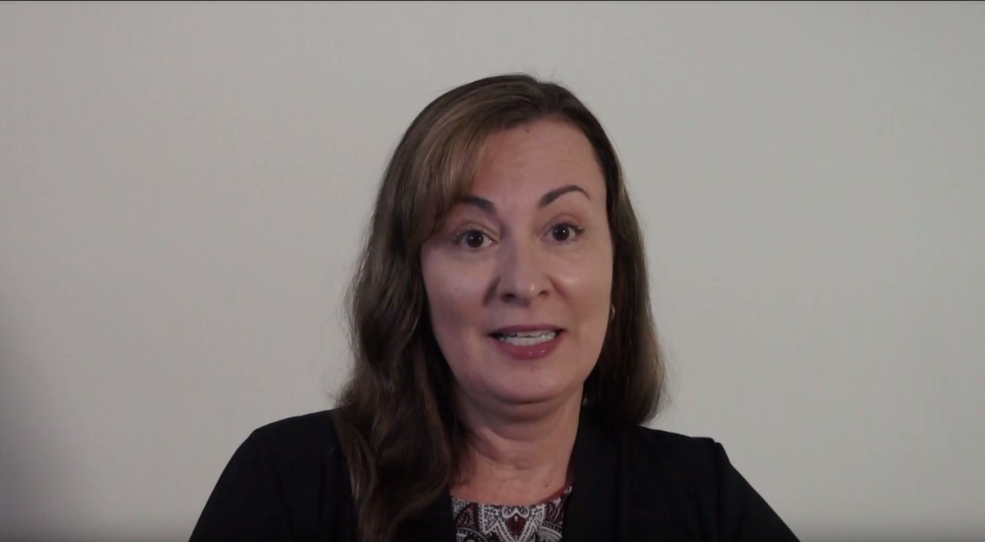
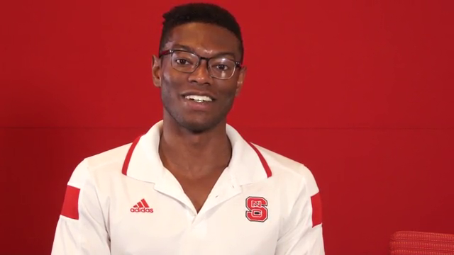
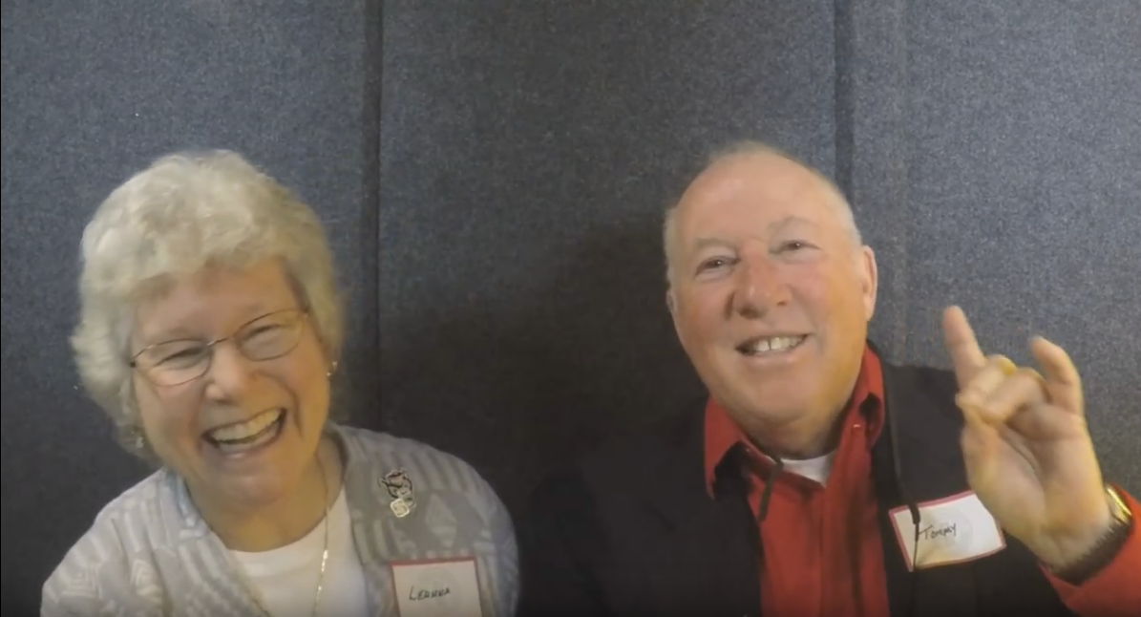
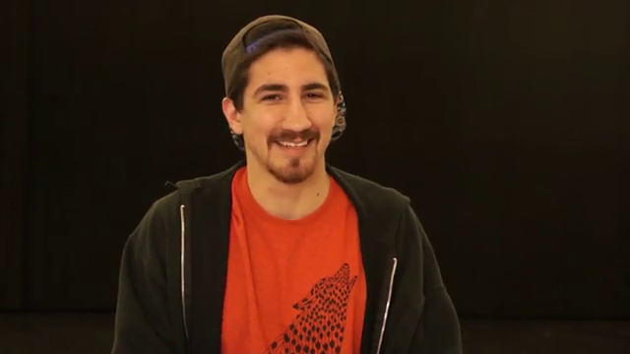
99 stories captured (and counting)
Building recurring partnerships
Expanding diversity and use of stories
Notes:
Recordings continue to broaden the range of voices now represented in the archives
Alumni as early as the class of 1942
Voices of GLBT, Muslim, Latinx, African American, Native American, South and East Asian, and Military Veteran communities
Continually building relationships and awareness
Recurring partnerships for annual recording events – GLBT Center (Lavender Graduation), Military and Veteran Resource Center (“Our State, Our Veterans” story project), Association of Women Faculty (recording days every semester, launching at AWF showcase on Nov. 1)
Listening to partners’ needs and facilitating mutual goals
Open recording days every semester
Expanding range of voices in archives – engaging community partners in documenting their own history, through their own voices
Encouraging research use of the collection, especially among community partners – examples: screenings at student orientations (Student Veterans Orientation, Aug. 2017), documentary film in production by student group EKTAA, workshops (e.g. Women’s Center’s “Counterspaces” counter-storytelling series), and more. Future potential uses in classes, research, student podcasts, etc.

Slide 8
go.ncsu.edu/wolftales
library_wolftales@ncsu.edu

