Slide 1
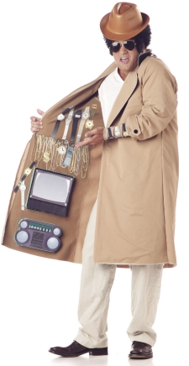
Black Markets for Scholarship
Notes:
https://thewinnower.com/papers/3489-signal-not-solution-notes-on-why-sci-hub-will-not-open-access
http://crln.acrl.org/content/78/2/86.full

Slide 2
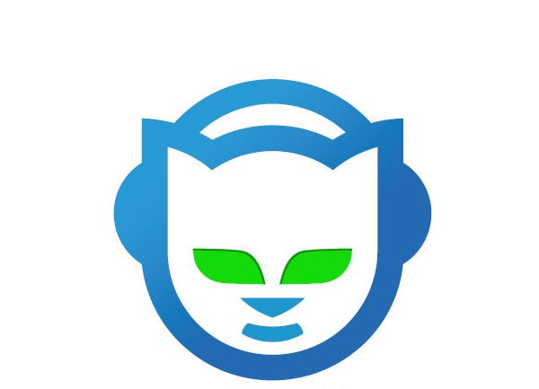

Slide 3
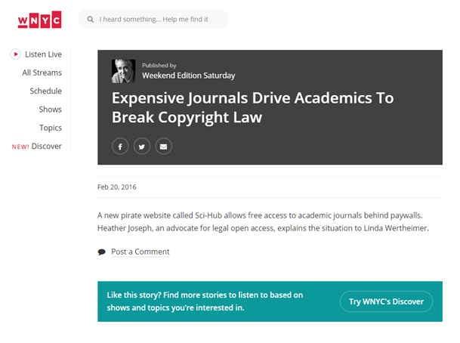

Slide 4
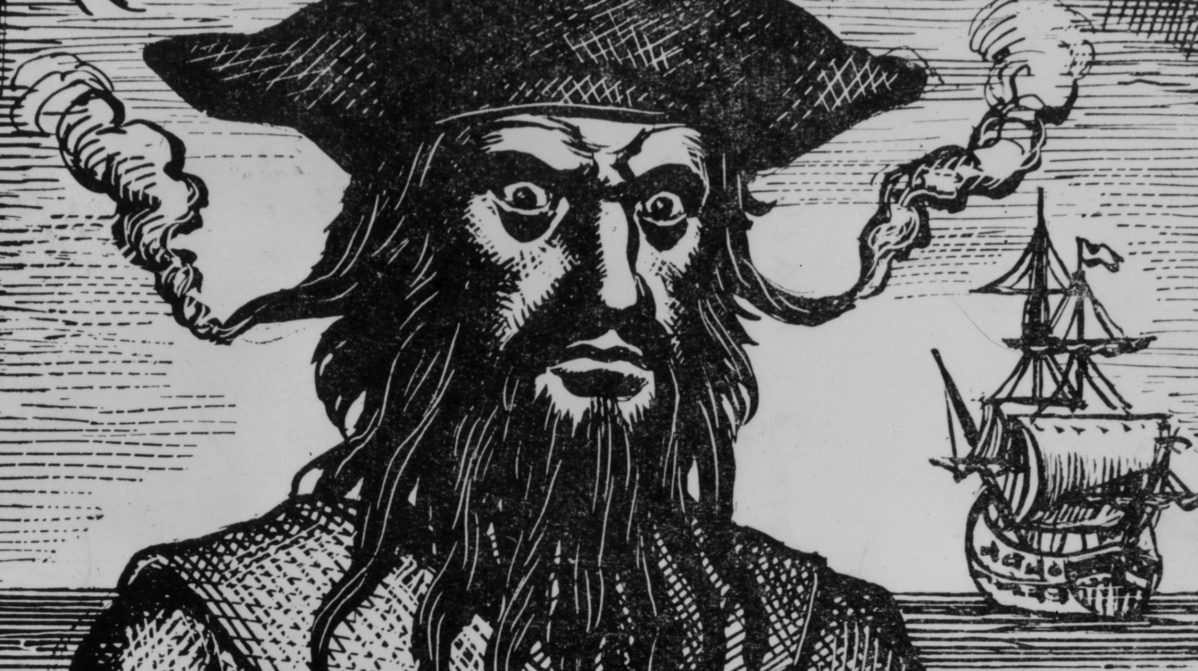

Slide 5
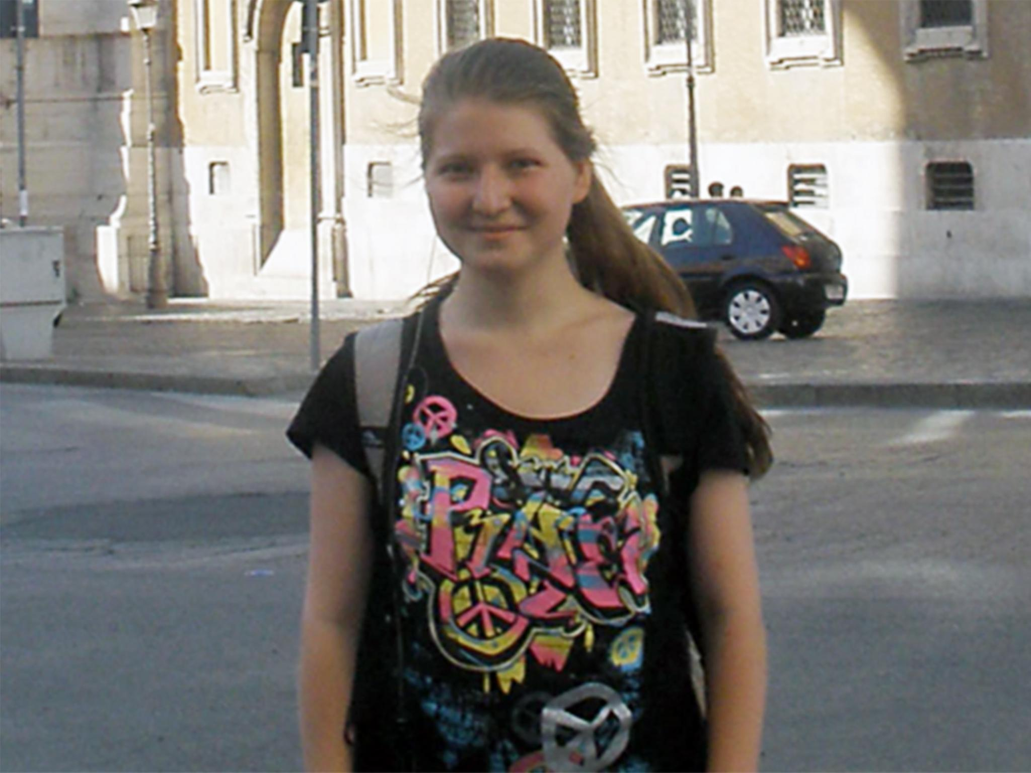

Slide 6
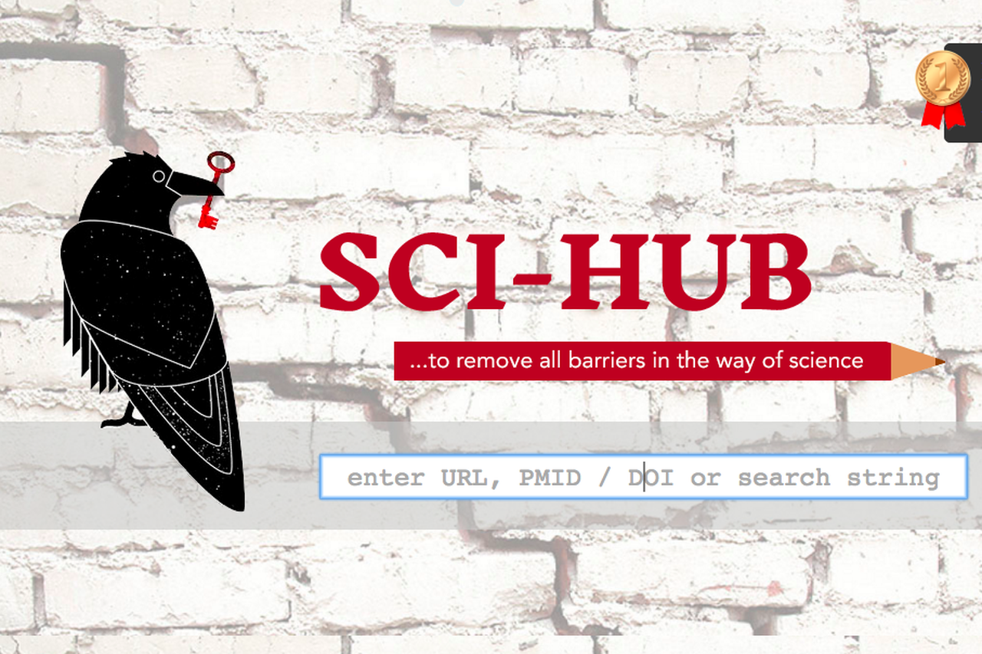

Slide 8
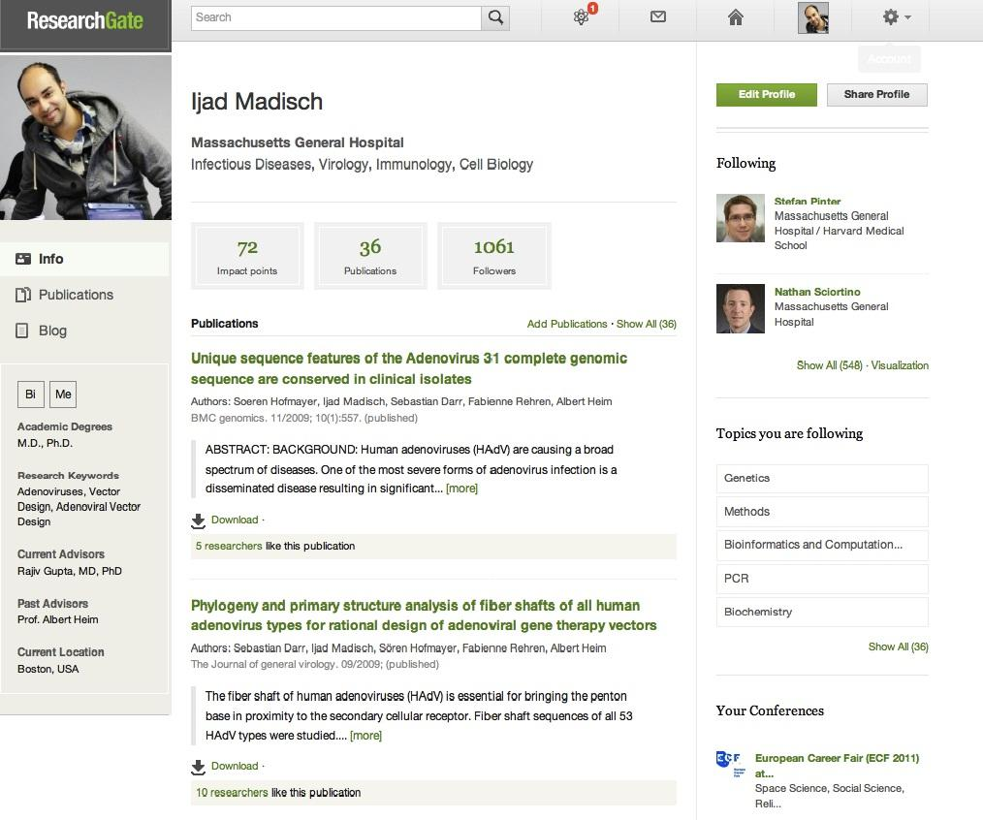
Notes:
Site members may "follow" a research interest, in addition to following other individual members.[11] It has a blogging feature for users to write short reviews on peer-reviewed articles.[11] ResearchGate indexes self-published information on user profiles to suggest members to connect with others who have similar interests.[4] When a member posts a question, it is fielded to others that have identified on their user profile that they have a relevant expertise.[12] It also has private chat rooms where users can share data, edit shared documents, or discuss confidential topics.[13] The site also features a research-focused job board.[14]
As of 2016, it has 11 million users,[2] with its largest user-bases coming from Europe and North America.[15] Most of ResearchGate's users are involved in medicine or biology,[11][13] though it also has participants from engineering, computer science, agricultural sciences, and psychology, among others.[11]
ResearchGate publishes a citation impact measurement in the form of an "RG Score". RG score is not a citation impact measure. RG Scores have been reported to be correlated with existing citation impact measures, but have also been criticized as having questionable reliability and an unknown calculation methodology.[16][17][18][19] ResearchGate does not require peer review or fees.[20]

Slide 9
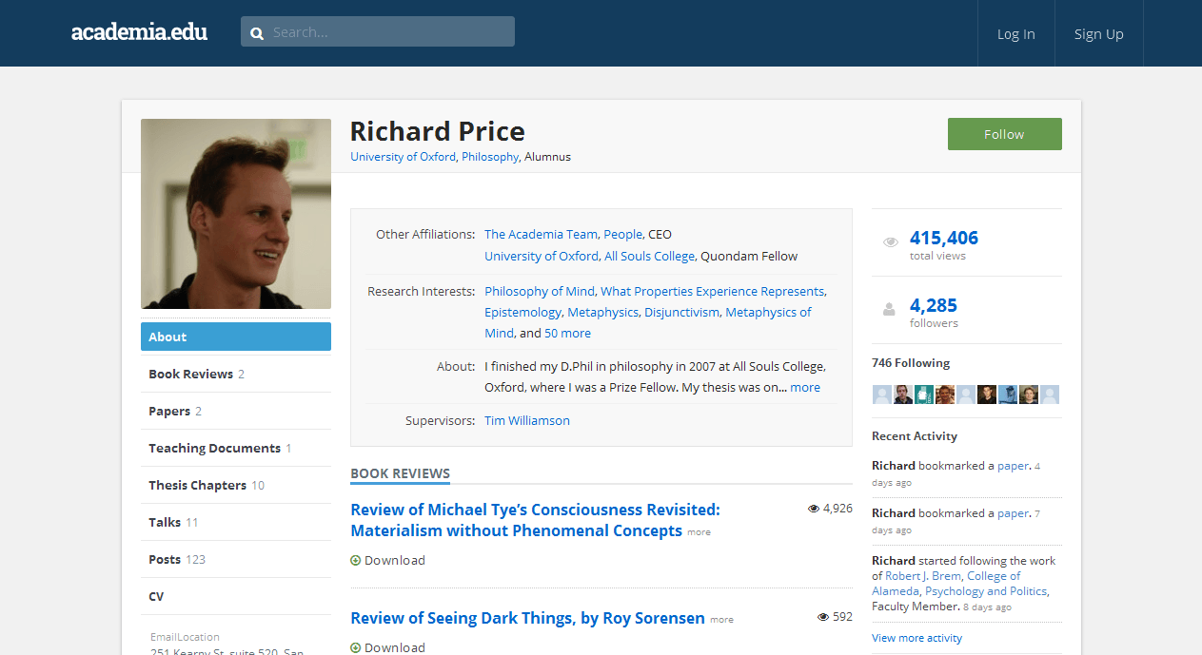

Slide 10
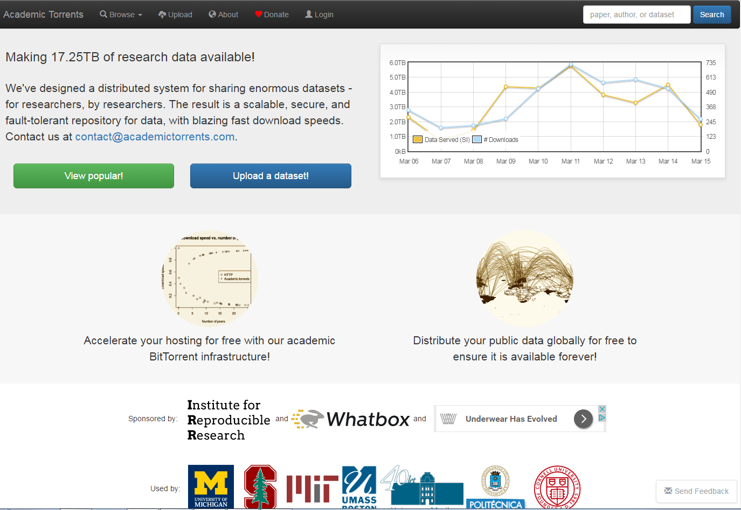

Slide 12
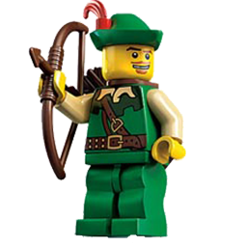
Why (Some) People Love Sci-Hub

Slide 13
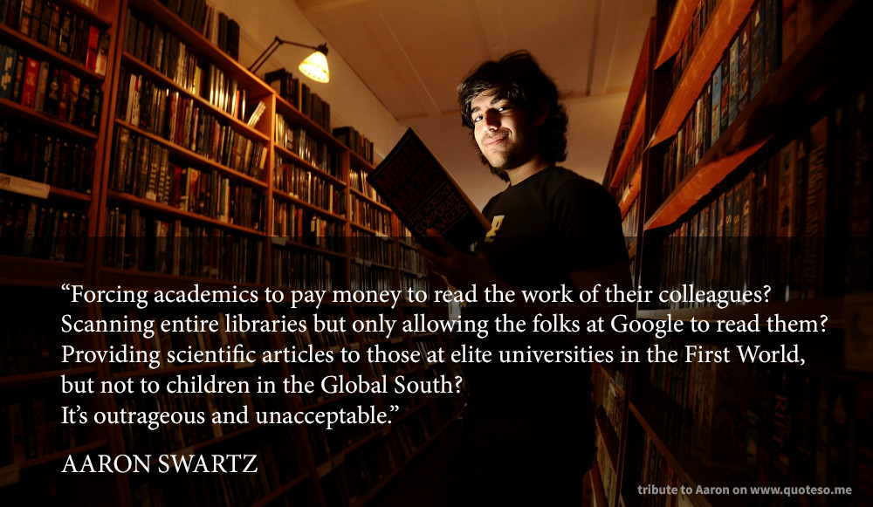

Slide 15
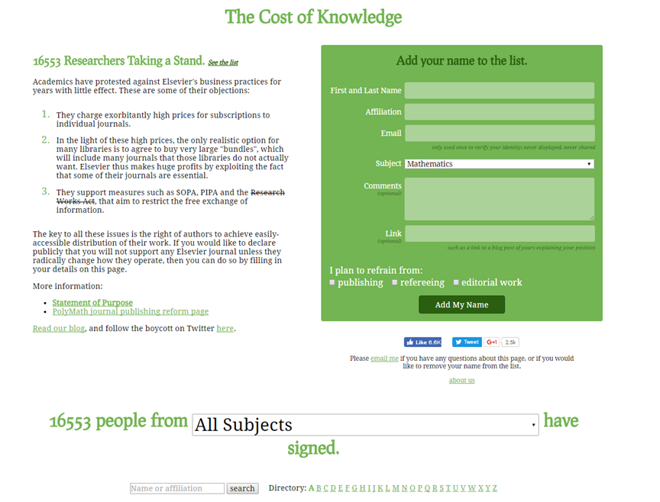

Slide 16
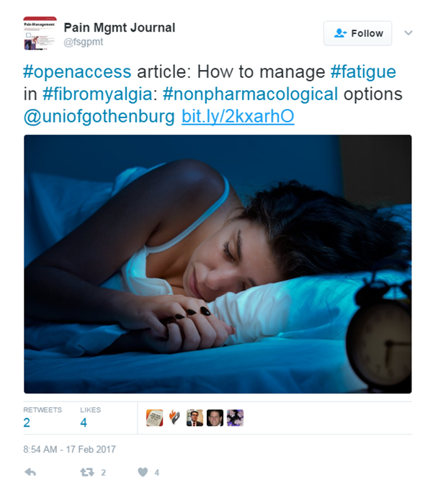

Slide 17
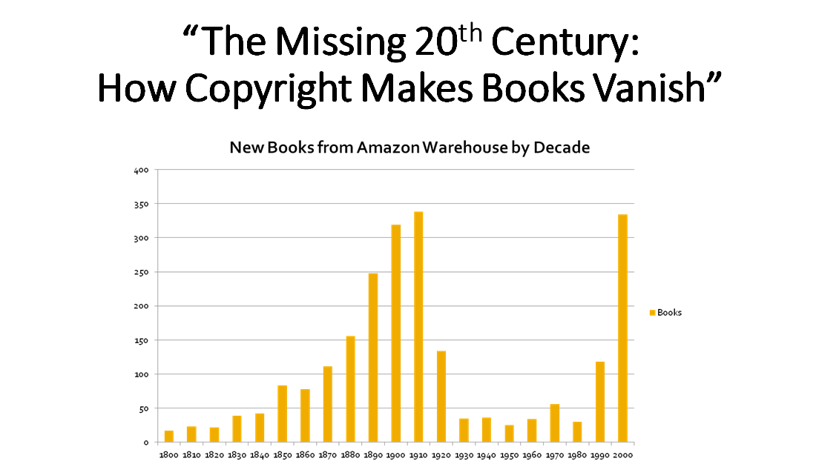

Slide 18
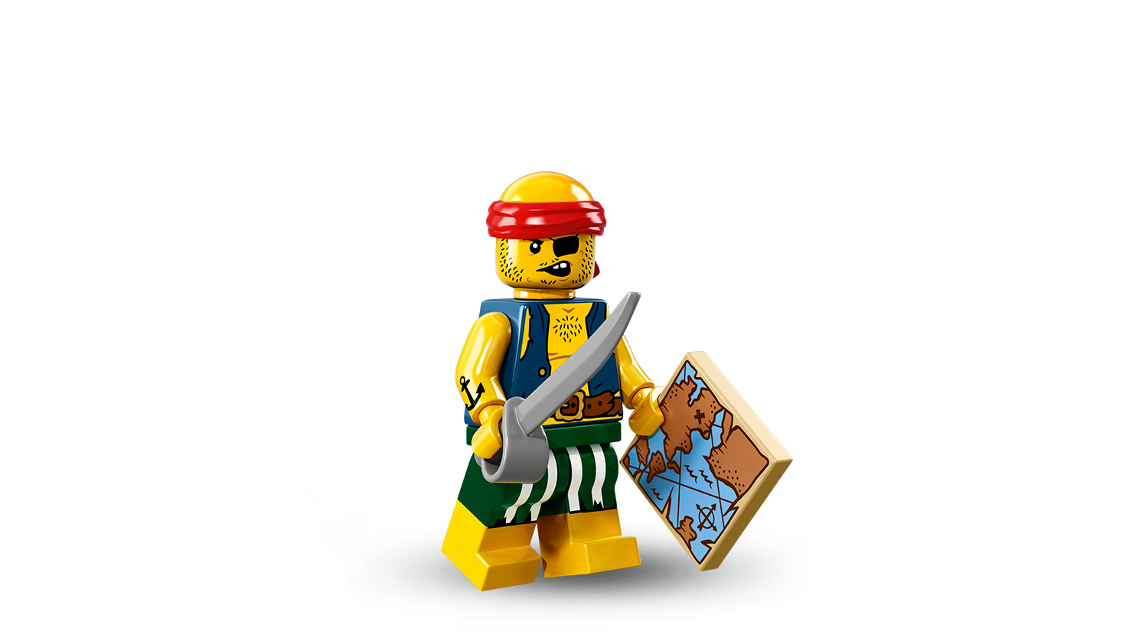
Why (Some) People Hate Sci-Hub

Slide 20
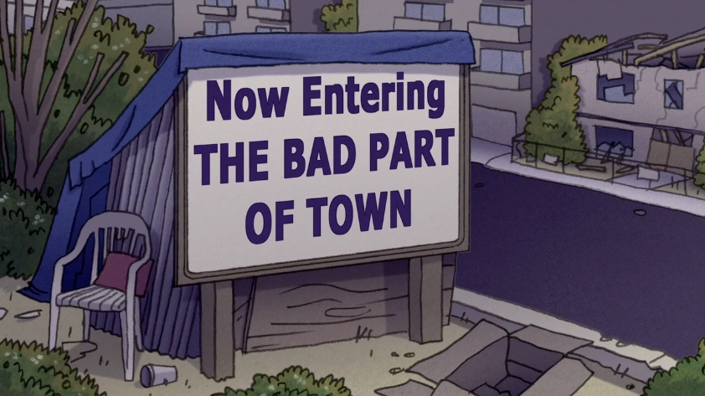

Slide 22
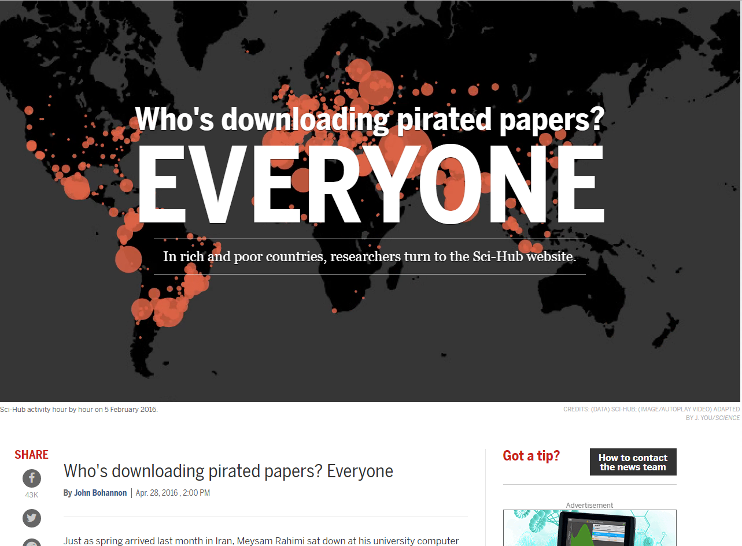
Notes:
http://www.sciencemag.org/news/2016/04/whos-downloading-pirated-papers-everyone

Slide 24
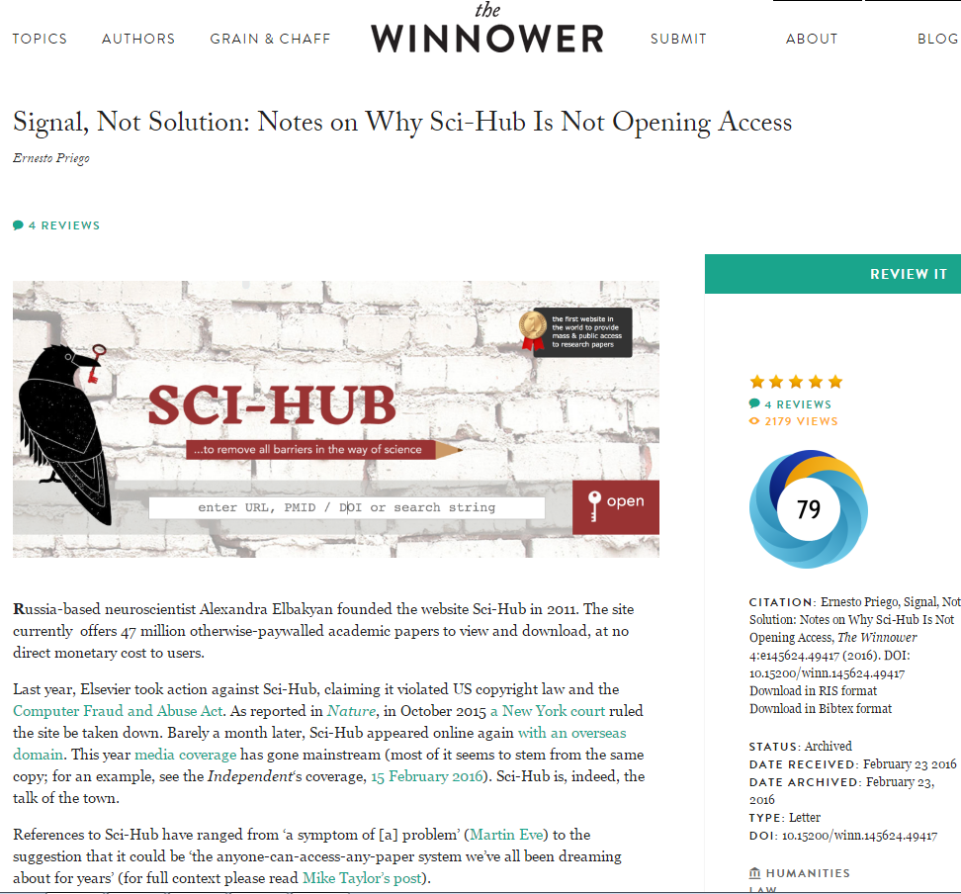
“Sci-Hub is creating awareness of a problem. It can lead to sustainable solutions, but as it stands now, by itself, it does not offer the solution.”
-Ernesto Priego

Slide 29
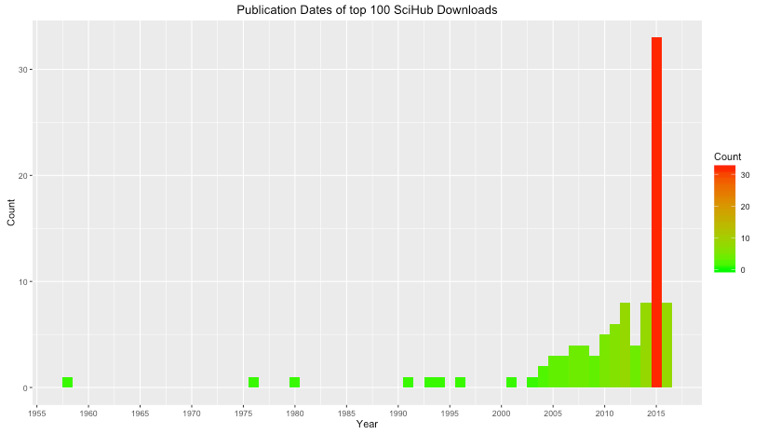

Slide 30
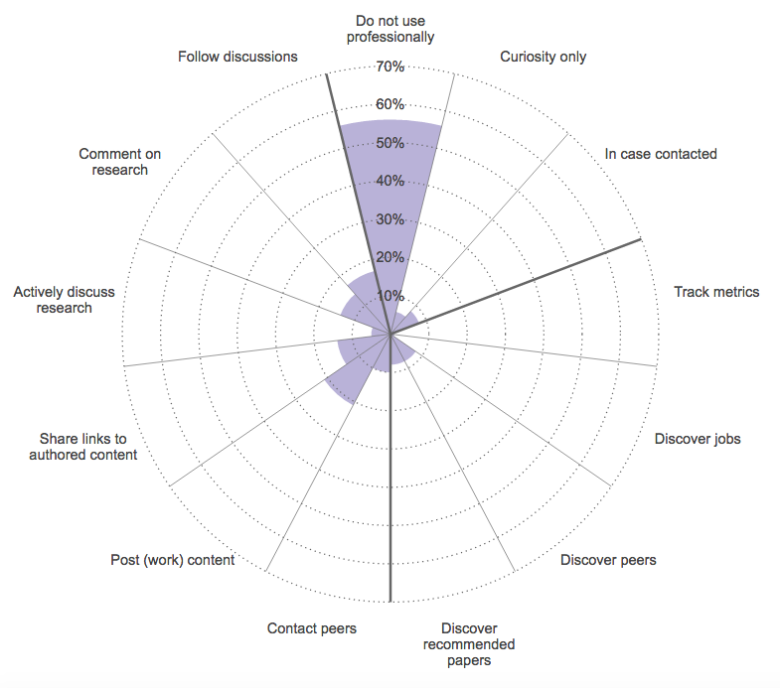
Facebook
Richard Van Noordan, Online Collaboration: Scientists and the Social Network, 2014 (Nature) http://www.nature.com/news/online-collaboration-scientists-and-the-social-network-1.15711#/
Notes:
Facebook - many do not use this professionally

Slide 31
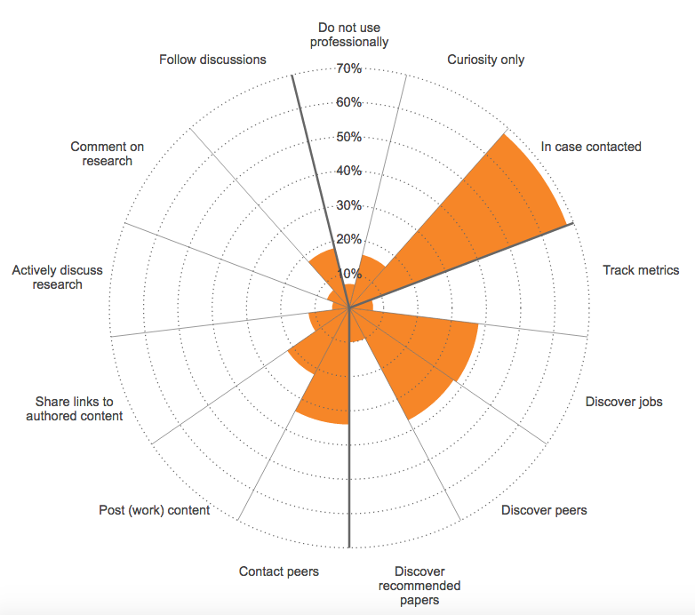
LinkedIn
Richard Van Noordan, Online Collaboration: Scientists and the Social Network, 2014 (Nature) http://www.nature.com/news/online-collaboration-scientists-and-the-social-network-1.15711#/
Notes:
LinkedIn - digital rolodex, to use so others can find you and get in contact

Slide 32
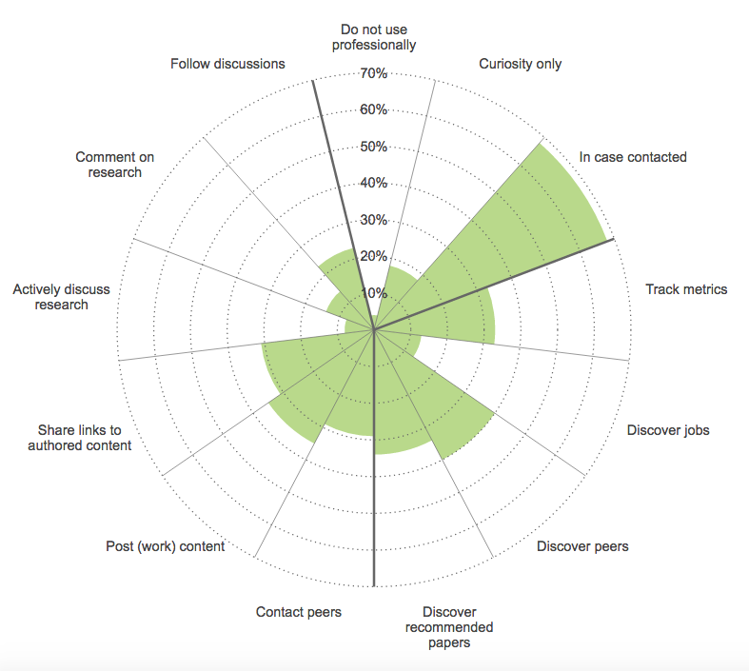
Richard Van Noordan, Online Collaboration: Scientists and the Social Network, 2014 (Nature) http://www.nature.com/news/online-collaboration-scientists-and-the-social-network-1.15711#/
ResearchGate
Notes:
ResearchGate

Slide 33
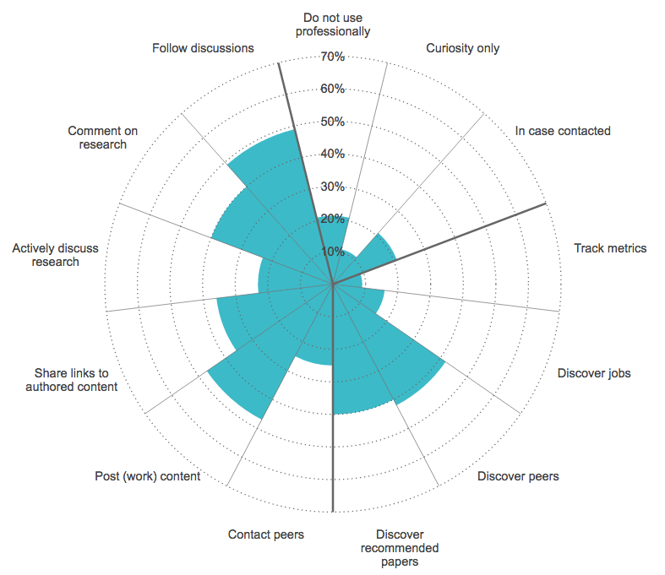
Twitter
Richard Van Noordan, Online Collaboration: Scientists and the Social Network, 2014 (Nature) http://www.nature.com/news/online-collaboration-scientists-and-the-social-network-1.15711#/
Notes:
Madison
Richard Van Noordan, Online Collaboration: Scientists and the Social Network, 2014 (Nature) http://www.nature.com/news/online-collaboration-scientists-and-the-social-network-1.15711#/
different options for which platforms you can use. nature did a survey on social media use and the reasons researchers use it.

Slide 34
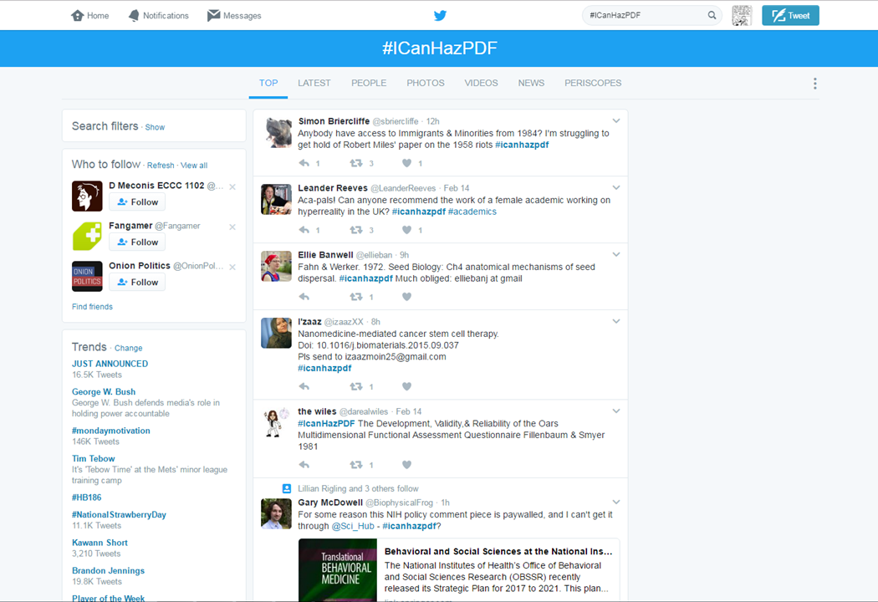

Slide 35
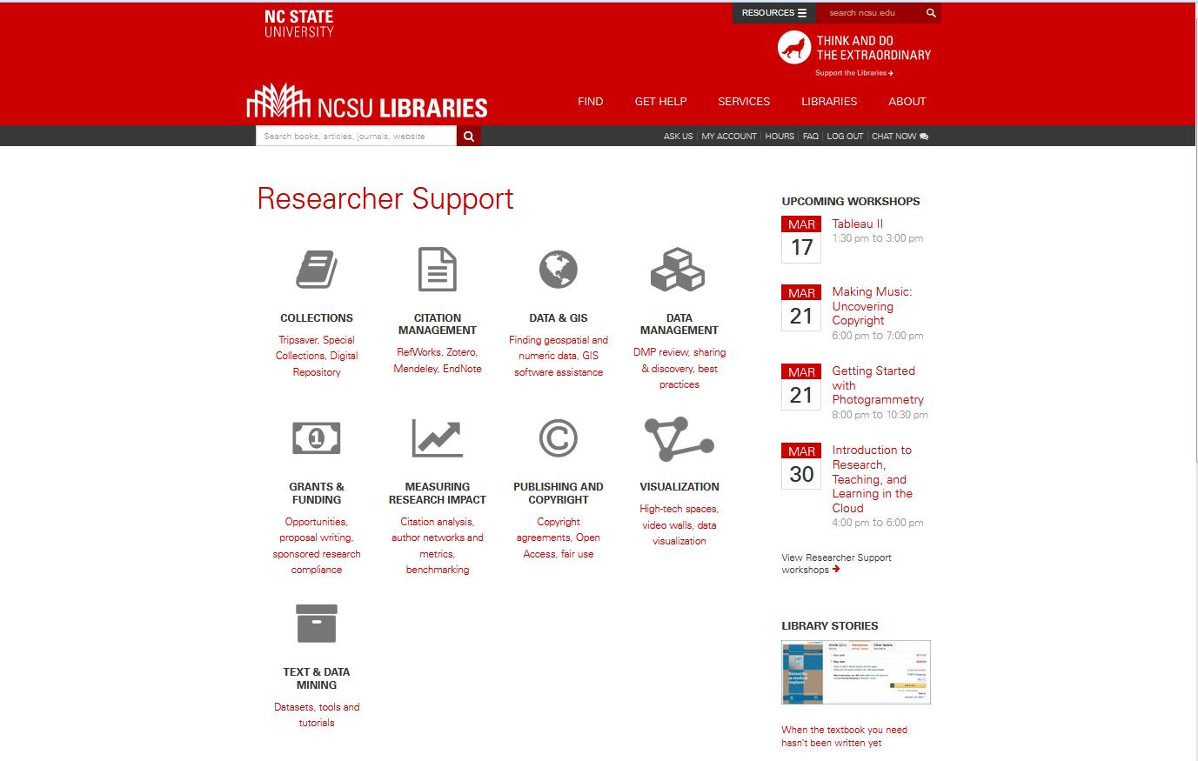

Slide 36
